Slide 1
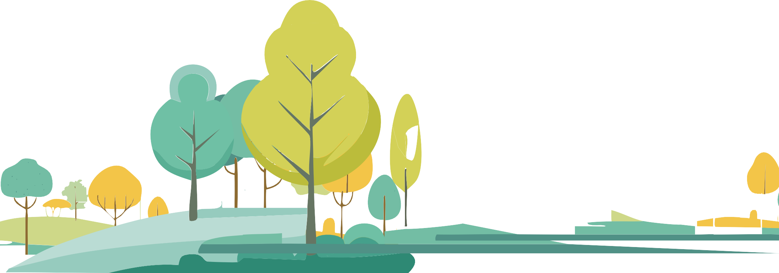
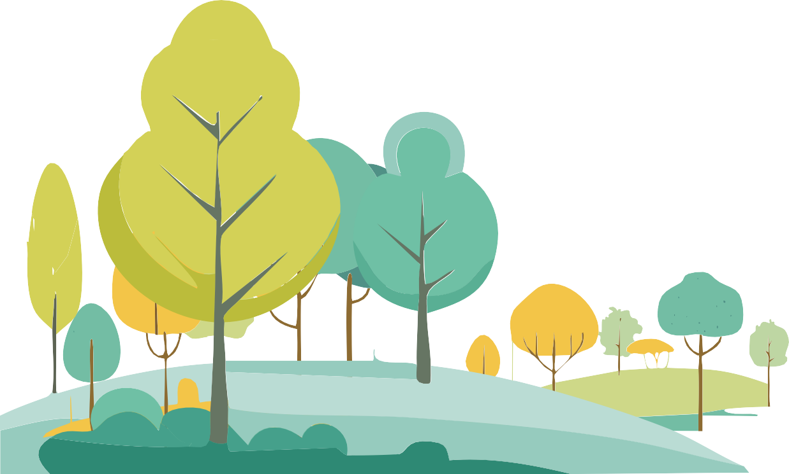
What Is a Forest?
I
Knowledge Box

Slide 2
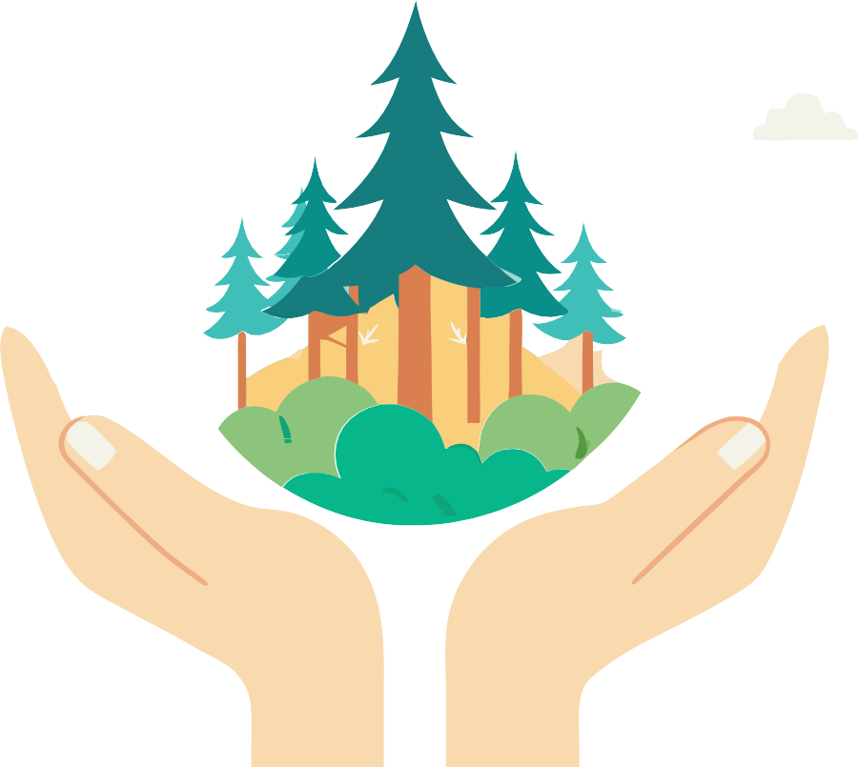
Educational materials realized with the support of
Forest Stewardship Council® - Adria-Balkan region program - FSC® F000100
Forests cover 31% of the world's land and are essential
for life on our planet

Slide 3
Sources
Follow the icons!
Let's Explore the Forest Ecosystem
Living organisms
Signs of a healthy forest
Want to know more? Search here for additional information.
4
4
4
Did you know?
Powerful forest decomposers: bacteria and fungi
5
Abiotic components 5
Keywords
These words are important for a full understanding of the content.
A Forest Is Made
Up of Trees 6
Praxis!
Parts of a tree and their mission 6 Transport of water and nutrients 6 Photosynthesis and transfer of nutrients 7
7
forest fauna
Media
microorganisms
secondary growth
forest ecosystem
Research
tree rings
xylem
cambium
Tree growth and development
Tree rings
7
primary growth
Reproduction of trees
8
Use your smartphone to scan QR codes. You'll need an app to scan the code with your camera.
Smartphones are really handy, so let's make the most of them!
phloem
humus
bisexual trees
Knowledge Quiz
9
mosses and lichens
fungi
forest flora
unisexual trees

Slide 4
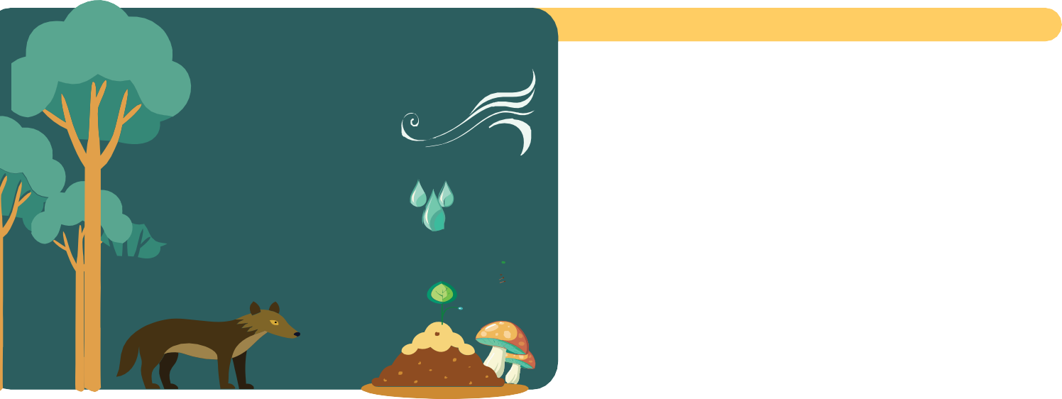
Living organisms
Forest flora consists of seed plants, mosses and ferns. Various trees, as well as shrubs, make up the dendroflora of a forest, which is studied by a special science called dendrology. Deciduous trees that grow in a forest are seed plants, while conifers belong to the group of gymnosperms.
Forest fauna consists of a variety of mammals, birds, insects, reptiles and amphibians that inextricably share their living space in the forest.
Energy flows through the forest ecosystem through food chains, starting from primary producers (plants) to primary consumers (herbivores) and secondary consumers (predators).
Animals such as deer, rabbits and insects feed on plants, controlling their growth and spread.
Soil Water Air
Animals Plants Fungi
Microorganisms
Besides numerous herbaceous plants, forests are home to mosses and lichens.
Lichens are made up of a fungus and algae or cyanobacteria that live together in a mutually beneficial relationship.
Mosses are a group of the simplest land plants, comprising about 23,000 species.
Let's Explore the Forest Ecosystem
A forest ecosystem is a complex system that includes living organisms and non-living components.
Many animals, such as bees, butterflies, and birds, pollinate plants, while others, such as birds and mammals, help disperse seeds.
Signs of a healthy forest
Predators such as wolves and birds of prey control herbivore populations, preventing overgrazing that can damage vegetation.
Mosses and lichens play an important role in maintaining the health of forest ecosystems by ensuring air quality and soil stability.
They absorb pollutants from the air, including heavy metals and other toxic substances. They act as natural filters, improving the air quality in the forest. Lichens are very sensitive to air pollution, so their absence can be indicative of the level of pollution. They thus serve as bioindicators, helping to monitor the ecological health of forests.
Media
Living organisms that inhabit a forest are animals, plants, fungi and microorganisms, while the non-living components that make up a forest are soil, water and air.
"Sharing Wildlife Sounds From All Over the Word"

Slide 5
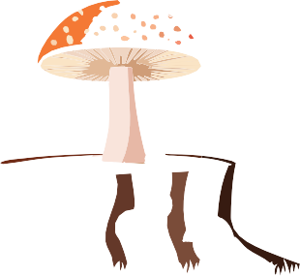
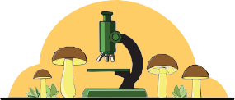
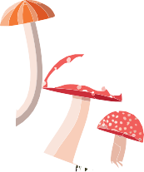
Did you know?!
Abiotic components
This is what we call the soil, water and air, which also form an important part of the forest ecosystem. The soil in the forest can be of different composition (carbonate, silicate, clay, sandy or loamy soil...) which primarily depends on the climate zone in which the forests grow. The science that deals with soils and their composition is called pedology.
The layer of forest soil rich in organic matter is called humus.
It is formed by the natural processes of decomposition of leaves, twigs, bark, plant and animal remains that are deposited on the forest floor.
Earthworms (Lumbricidae) are worms that live in the soil and feed on organic matter. They bring plant remains into the soil by breaking them down in their digestive system, and then excrete them as rich, nutritious material – the basis of humus.
Water can reach the forest through rain, or be present in lakes, rivers and various watercourses that provide habitats for numerous aquatic organisms. Plants release water into the atmosphere through transpiration, so forests help regulate temperature and humidity.
If a forest receives clean air, this will primarily affect the health of organisms and the vitality of the entire ecosystem.
Organisms such as fungi, bacteria and various invertebrates break down dead plants and animals, returning nutrients to the soil.
Fungi are microscopic in size and can cause rot, infections, or mold on food.
Mushrooms are visible to the naked eye, can be collected in the forest, and eaten if they are edible.
Fungi are organisms that do not possess chlorophyll and do not sexually reproduce like plants or animals, so they are a kingdom unto themselves.
Fungi act as “extensions” of plant roots and often live in symbiosis with numerous plant species. This phenomenon is called mycorrhiza.
In their mycelium, fungi retain water that plants draw from their roots and at the same time obtain valuable minerals for their growth.
In return, plants produce (carbohydrates) through photosynthesis, which they share with the fungi, thus providing them with energy for growth.
Powerful forest decomposers:
bacteria and fungi
Bacteria can break down soil pollutants like pesticides, heavy metals, and other toxic compounds, helping to clean and maintain soil quality.
Some bacteria have the ability to fix atmospheric nitrogen, turning it into a form plants can use. This is crucial for enriching soil with nitrogen, an essential nutrient for plant growth.
Without microorganisms, such as bacteria and fungi, many processes in forests would not be able to function, which would lead to a disturbance of the ecological balance.
Wood-decay fungi are the most efficient organisms in breaking down lignin, a complex polymer that constitutes wood.
This process is essential for recycling nutrients
from dead trees and plant material.

Slide 6
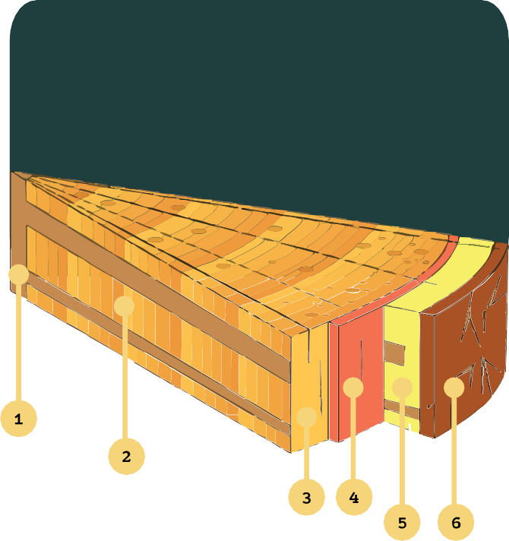
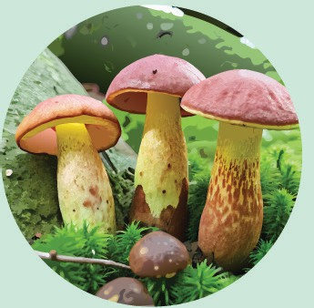
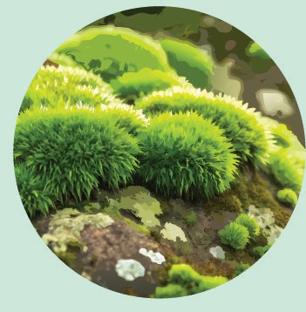
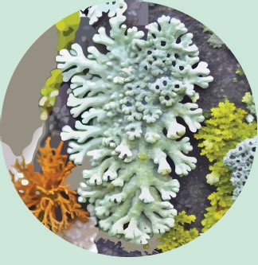
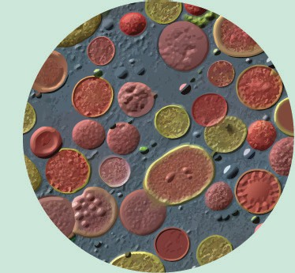
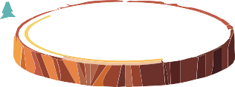
Tree Structure
Heartwood
Tree Rings
Xylem
Cambium
Phloem
Bark
A Forest Is Made Up of Trees
Parts of a tree and their mission
Different parts of the tree work together to allow it to grow, develop, reproduce, and survive in various conditions.
Praxis!
Look at the images and write the correct name for each type of organism.
Here are some ways the tree parts collaborate.
Did you know?!
Wood ≠ Tree
Wood is the building material or tissue that makes up a tree.
Trees are living organisms that grow and die.
Transport of water and nutrients
Roots absorb water and minerals from the soil. These are transported to the trunk
and branches, and then to the leaves.
The tissue that conducts water and minerals from the roots to the leaves is called xylem. It serves as a one-way transport system from the roots to the top of the tree.

Slide 7
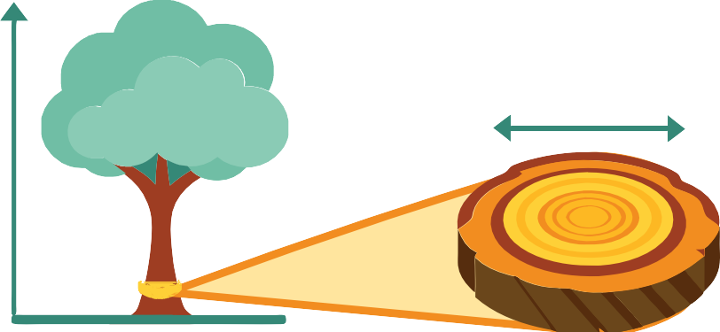
Photosynthesis and nutrient transport
Tree growth and development
Tree growth is a complex process that involves cell division, differentiation, and cell elongation. The growth process includes primary and secondary growth, each with specific mechanisms and structures.
Leaves carry out photosynthesis, converting sunlight, carbon dioxide, and water into glucose and oxygen.
Secondary growth allows a tree to grow in width (thickening of the trunk, branches, and roots). This growth occurs in the cambium.
The cambium is located between the xylem (inner wood) and phloem (outer tissue), and it produces new layers of xylem inward and phloem outward.
As new layers of xylem and phloem are added each year, the tree increases in width.
Glucose (sugar) is used as an energy source and building block for tree growth.
Primary growth allows the tree to grow in height (elongation of roots and shoots).
Cell growth in length occurs in the apical meristems located at the tips of roots, shoots, and branches.
Phloem is the tissue that carries sugars produced from the leaves to all parts of the tree. Phloem enables two-way transport because sugars can travel from the leaves to the roots and all other.
The production of new cells occurs through the division of meristematic cells, which then differentiate into specialized tissue cells such as xylem, phloem, and ground tissue.
Tree rings
The xylem creates rings that are visible in a cross-section of the tree. During springtime, spring (early) wood is formed, which has larger cells and thinner walls due to rapid growth, while autumn (later) wood has smaller cells and thicker walls.
Did you know?!
Bark protects the tree from physical damage, diseases, and insect attacks. Bark produces toxins or resins to repel herbivores and pathogens.
Tree rings can provide information
about the age of the tree, climatic
conditions, and environmental events
during the tree's growth.
Resin that oozes from wounds in the bark helps to seal the wound and prevent pathogens from entering.
Roots and trunk store reserve nutrients like starch and oils. These reserves are used during unfavorable conditions (e.g., winter) or to support new growth in the spring.

Slide 8
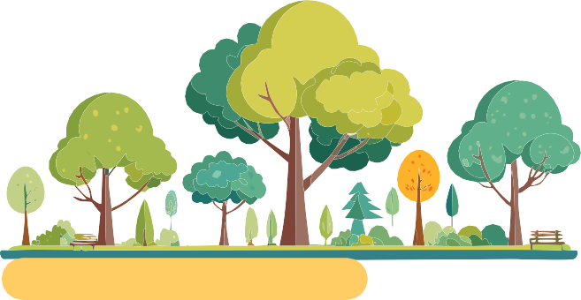
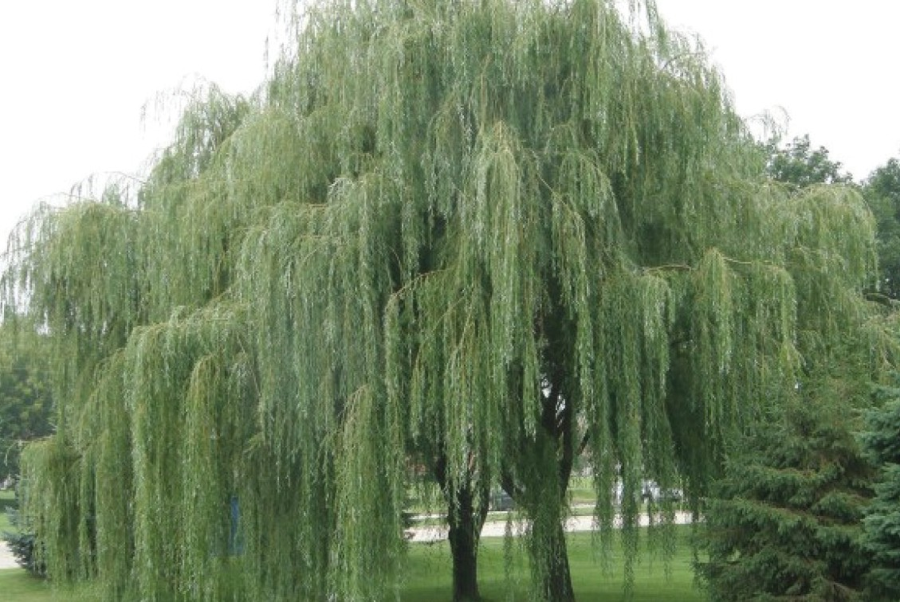
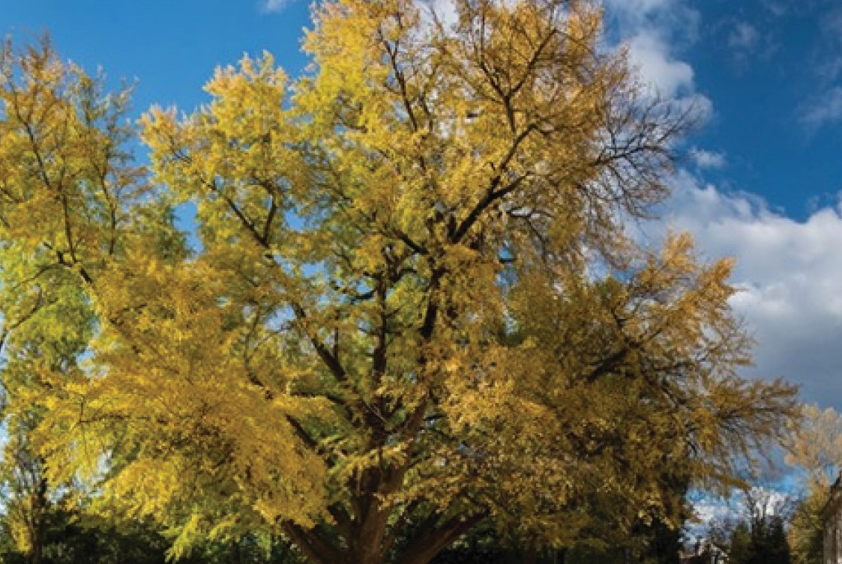
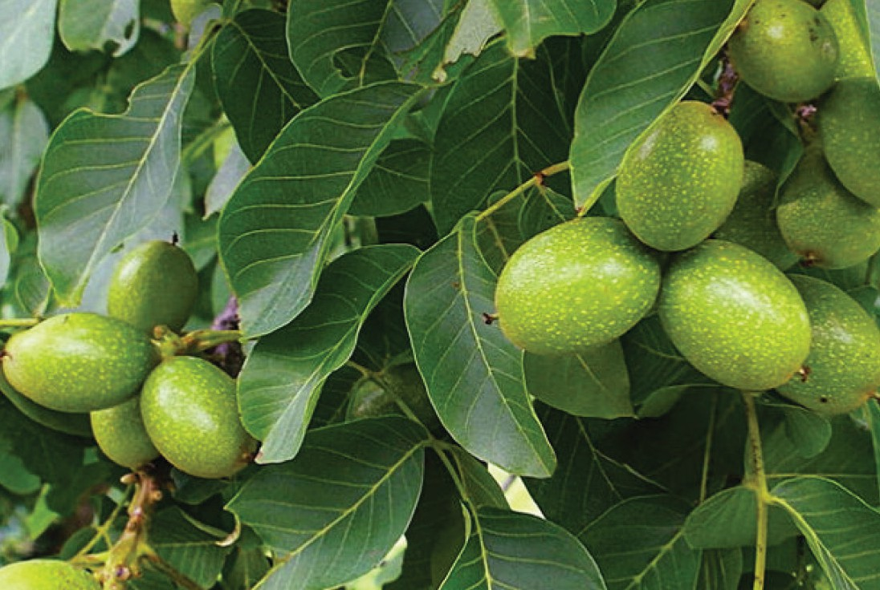
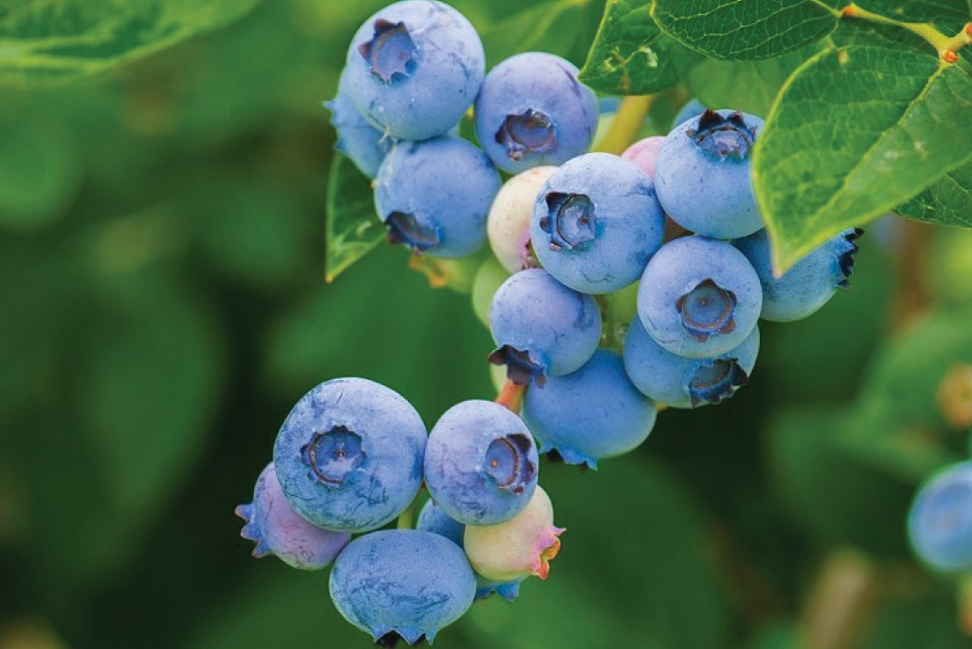
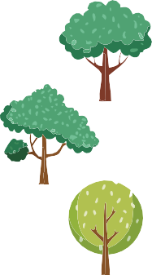
Media
Examples of Unisexual Trees
Willow and ginkgo: male trees produce pollen, while female trees carry seeds.
Reproduction of trees
"How Does a Tree Grow? Not What You Think!"
07:06 min.
In trees, we have unisexual and bisexual trees. Unisexual trees are those that bear only male or only female flowers.
Male trees produce only male flowers, and these flowers produce pollen. Female trees have only female flowers, and these flowers contain ovules that, after pollination, become fruits.
Examples of bisexual trees
Walnut and blueberry: male and female organs are found within the same flower, which allows the plant to produce fruit after pollination.
In coniferous trees, we do not have flowers, but cones are simple male reproductive organs that produce pollen for pollination. The female reproductive structures are called ovules and are found in female cones.
Bisexual trees (also known as hermaphroditic trees) are trees that have flowers that contain both male and female reproductive organs.
This means that each flower on the tree produces pollen and ovules, so self-pollination will occur.

Slide 9
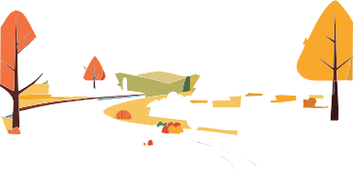
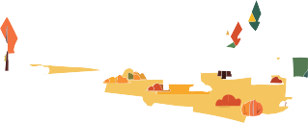
Praxis!
Educational Forest Walk
Search for questions and answers in digital format.
In the second part of the walk, we'll focus
on biotic factors; plants, animals, and mushrooms.
Each group will go on a hunt and photograph:
Knowledge Quiz
Materials:
camera
paper
colored pencils
pens
Divide students into small groups and take a walk in the forest. Teams will explore the forest and focus on abiotic (soil, water, air) and biotic (plants, animals, mushrooms) components of the forest ecosystem.
Media
Did you know that trees communicate with each other, interact, and form relationships
just like we do?
What are the biotic components of a forest ecosystem?
What are two indicators of a healthy forest?
What can bacteria do as powerful forest decomposers?
What is the relationship between plants and fungi?
Which organisms are the most efficient in breaking down lignin that makes up wood?
In which tissue of the tree does sugar transport to all parts of the tree occur?
Which part of the tree is responsible for the tree's width growth?
What information do the rings provide us?
What substances are stored in the roots and trunk?
What is the difference between unisexual and bisexual trees?
Different species of trees and shrubs (we'll focus only on woody species)
Various animals they encounter in the forest (insects, reptiles, mammals, birds, or others)
Mushrooms, lichens, and mosses found on the ground or on trees
In the first part of the walk, the guide invites students to focus on these abiotic components through direct observation and sensory awareness:
Discover how!
SOIL: its color and structure (is there humus?), what is the quality of the soil?
WATER: is there water in the forest, is moisture present?
AIR: what is the air quality, what is the scent in the air?
“The Secret Language of Trees”
When the students return from the forest to class, they will analyze all the photos taken and identify species of trees and shrubs, as well as animals and mushrooms they encountered during their walk in the forest.
After that, students will individually draw one of the three abiotic factors on paper using colored pencils, illustrating their experiences, sensations, and observations of this non-living component of the forest ecosystem.
15:58 min.
.

Slide 10
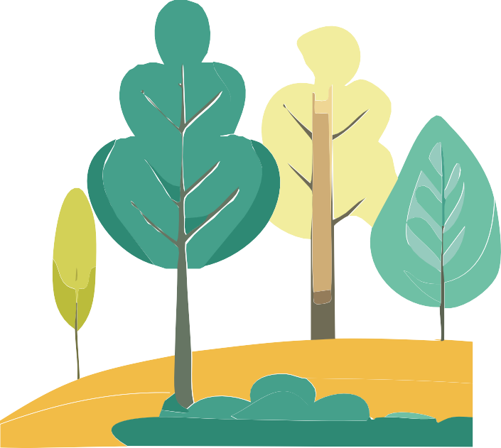
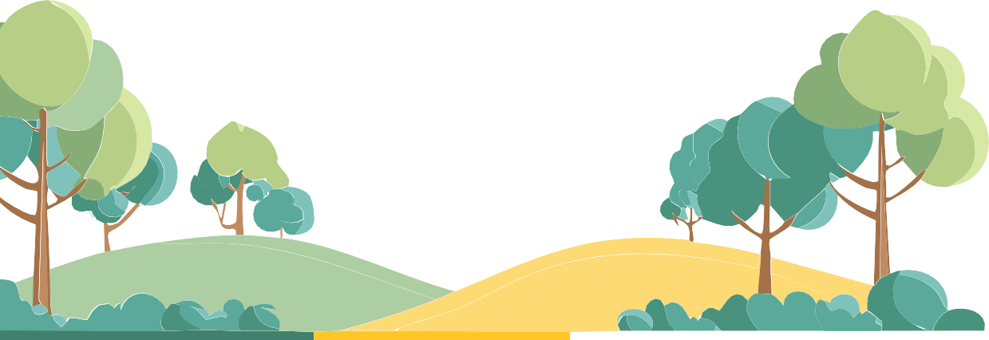
Graphic design
Educational materials realized with the support of
Forest Stewardship Council® - Adria-Balkan region program - FSC® F000100
Author, editor & publisher

