Slide 1
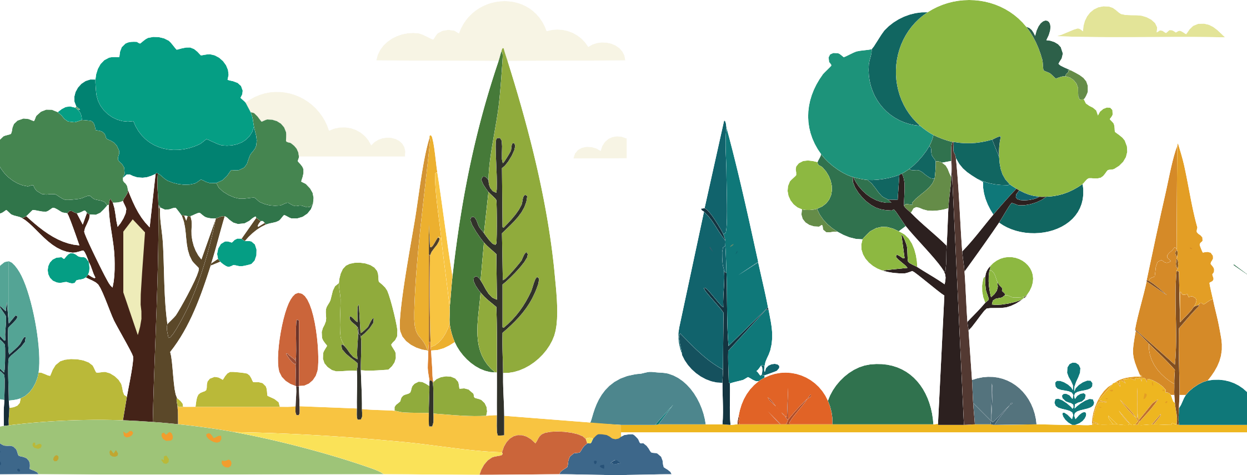
Diversity of Forests and Trees
Knowledge Box II

Slide 2
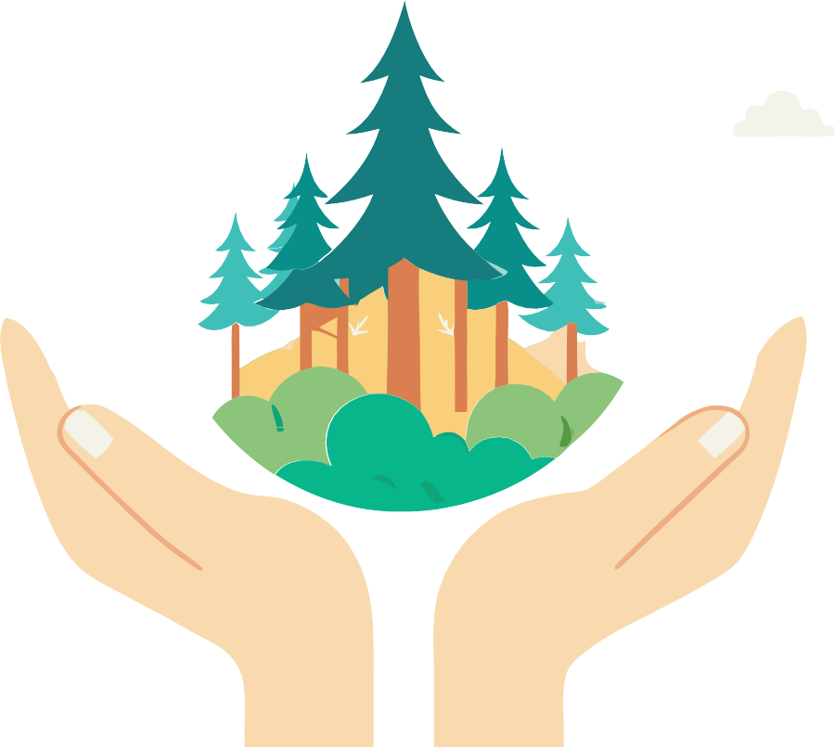
Educational materials realized with the support of
Forest Stewardship Council® - Adria-Balkan region program - FSC® F000100
Forests are home to 80% animal and plant species on Earth

Slide 3
Sources
Follow the icons!
There Are 70,000 Tree Species in the World ₄
Main regions and their diversity 4
Why is it important to have a large tree variety in forests?
Want to know more?
Search here for additional information.
Did you know?
5
Keywords
These words are important for a full understanding of the content.
Tree Species in Croatia and Europe
Coniferous and Broadleaf Trees
Evergreen and deciduous trees
Ecological Relationships in the Forest
Primeval Forests
in Croatia 10
Knowledge Quiz 11
Praxis!
5
7
8
climate –driven forest communities
Media
primeval forests
broadleaf trees
tropical forests
coniferous trees
predation
mutualism
Research
temperate forests
9
competition
boreal (taiga) forests
Use your smartphone to scan QR codes. You'll need an app to scan the code with your camera.
Smartphones are really handy, so let's make the most of them!
commensalism
biodiversity
evergreen trees
deciduous trees
ecological relationships

Slide 4
There Are 70,000 Tree Species in the World
Boreal forests (taiga) are found in cold, northern parts of the world such as Canada, Russia and Scandinavia and have a relatively low number of tree species, but cover large areas.
The number of tree species in the world is a fascinating topic that shows the richness and diversity of plant species on our planet.
Mountains, plains, rivers, and other topographic features create diverse habitats for different tree species.
According to the latest research, there are around 73,300 species of wild trees around the world. If we add to the trees and a variety of wild shrubs, it is estimated that this number exceeds 100,000 species with woody characteristics.
The Amazon rainforest alone may have over 16,000 species of trees.
Temperate forests cover climatic zones with distinct seasons. These are the forests of Europe, North America and East Asia, which have a lower but still significant diversity of trees.
Boreal forests generally contain a few dominant species such as spruce, pine, and fir.
Main regions and their diversity
Tropical forests are located near the equator and are characterized by high levels of precipitation and great biodiversity. The Amazon rainforest, the Congo rainforest in Africa, and the tropical forests of Southeast Asia have
the greatest diversity of woody species in the world. They are home to around 40% of all the worlds’ tree species.
Tropical tree species include baobab, mahogany, ebony, and many others.
This group also includes Mediterranean forests, which are found in areas with a Mediterranean climate such as the Mediterranean and California.
Oaks, beech, maple and hornbeam are very common in this zone.
Media
"Temperate Deciduous Forests"
03:25 min.
Europe has around 600 species of trees, while North America has around 1,000 species.

Slide 5
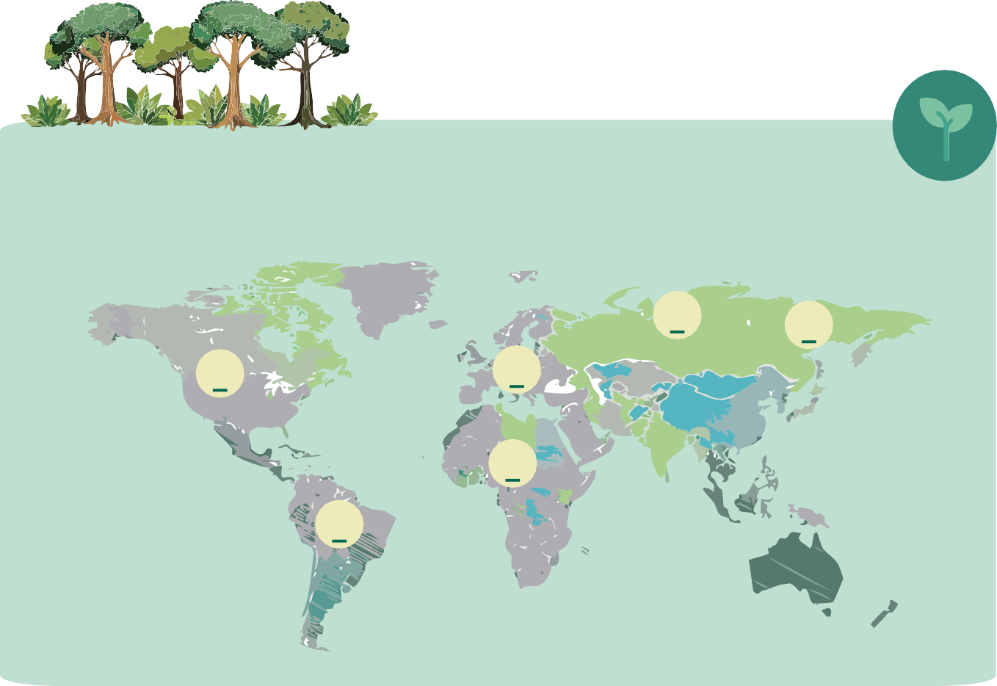
Research
Why is it important to have a large tree variety in forests?
Ecological function - forest ecosystems with a high diversity of trees often have more complex food webs, but also provide better ecosystem services such as carbon storage, water regulation, and soil conservation.
1. Why do some islands and isolated regions often have unique species that are found nowhere else in the world?
2. Why do tropical regions have high biodiversity, while boreal regions have much lower tree diversity?
Biodiversity - a greater diversity of trees supports a greater diversity of other organisms, including plants, animals,
fungi and microorganisms.
3. Can a fir tree survive in a tropical forest?
Explain your answers.
Adaptive capacity - diverse forest ecosystems are more resilient to environmental changes, such as climate change and pathogen attacks.
Praxis!
Mark the locations where these tree species grow.
Preserving the diversity of tree species is essential for maintaining healthy ecosystems, securing resources for future generations, and preserving the natural beauty and ecological balance.
Media
baobab
oak
mahogany
spruce
beech
fir
“Forests in Croatia”
09:04 min.

Slide 6
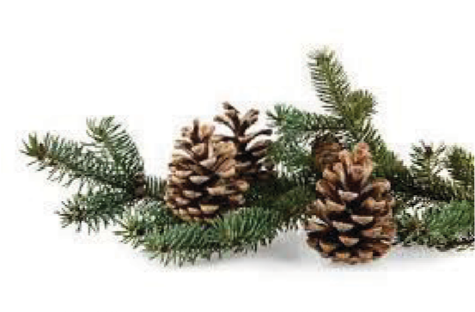
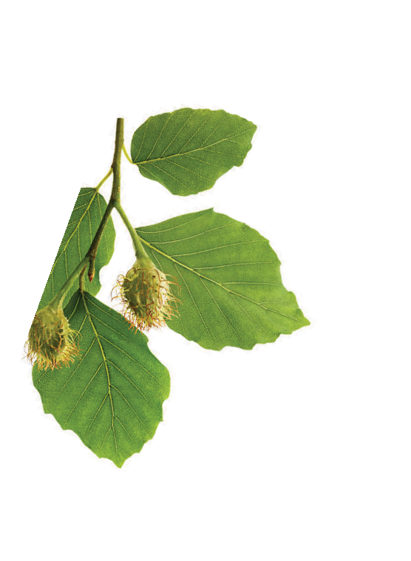
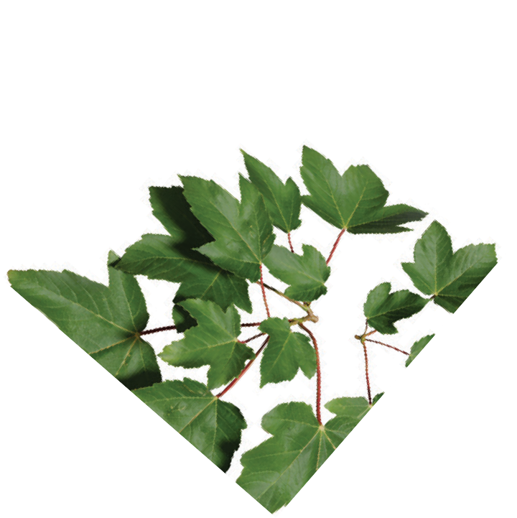
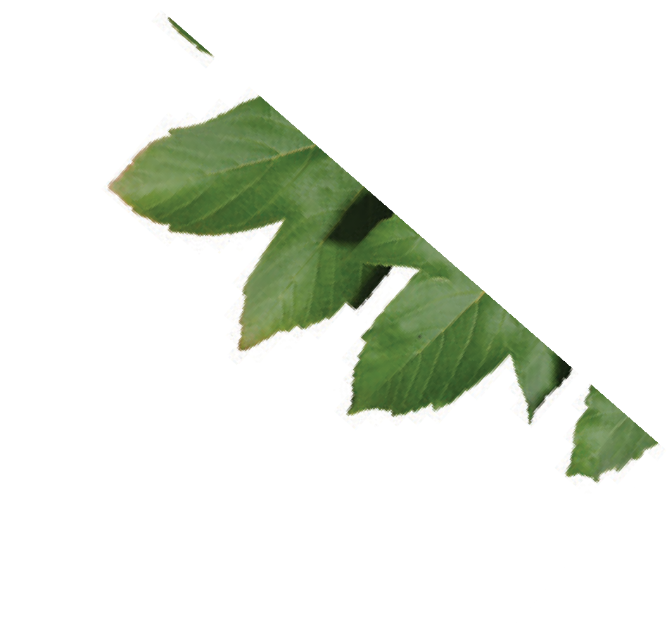
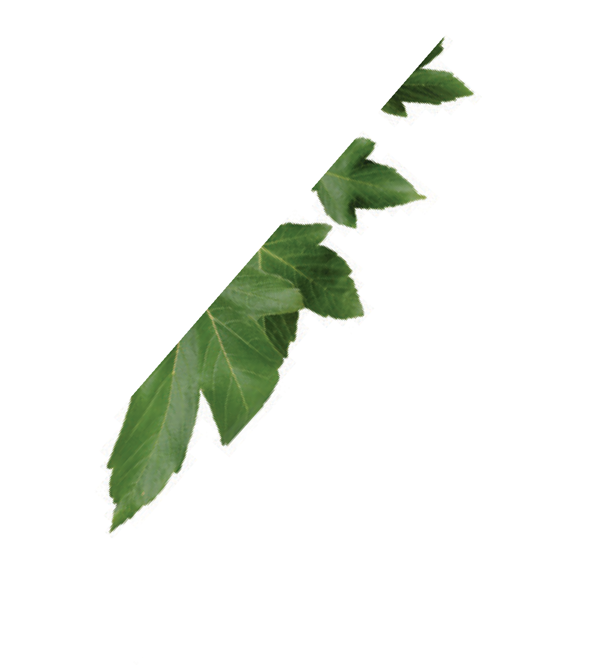
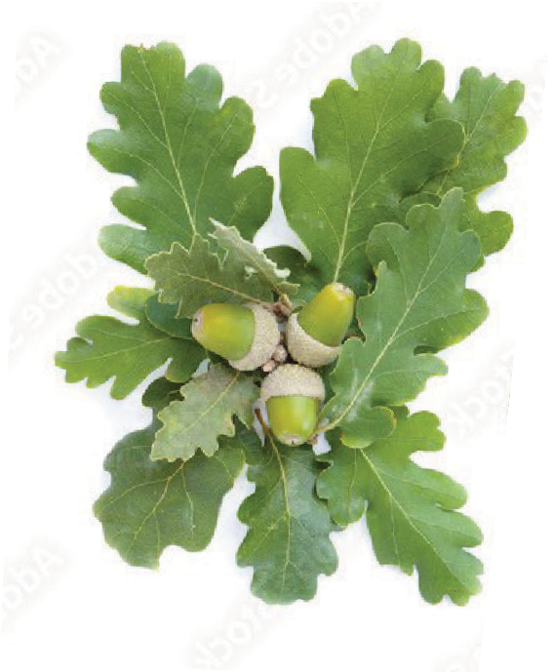
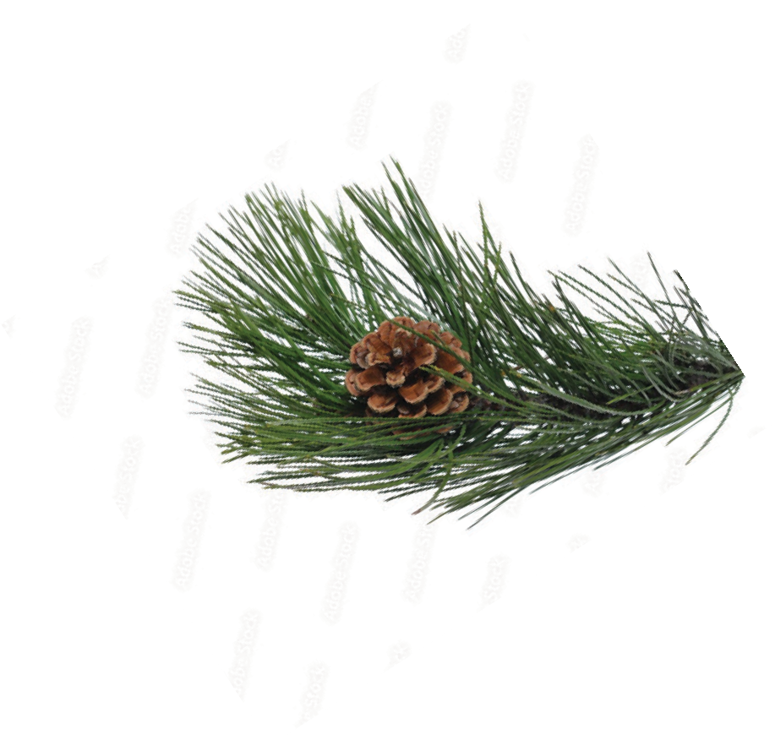
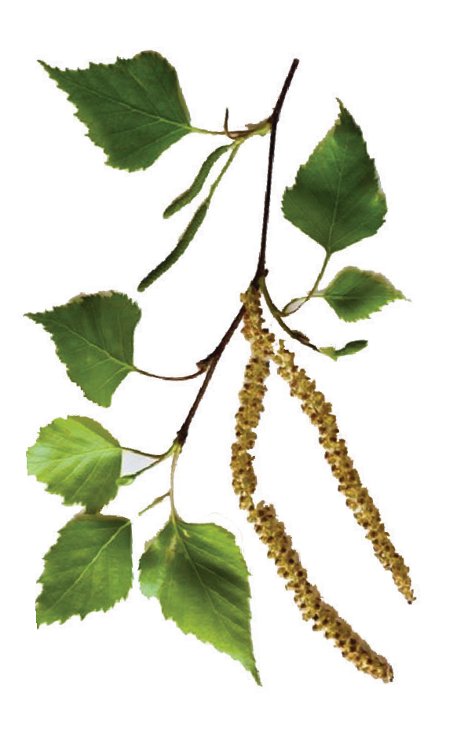
Tree Species in Croatia and Europe
Media
“Coniferous vs. Deciduous Trees”
Croatia has three main climate zones: Mediterranean climate along the coast, continental climate in the interior and mountainous climate in higher areas. These climatic and geographical diversities allow for the growth of numerous trees that form
climate-driven forest communities.
Fir trees (Abies sp.)
common fir (Abies alba),
These are found in European mountain forests. In Croatia, they are notably present in
the Gorski Kotar and Lika regions.
09:04 min.
Maples (Acer sp.)
field maple (Acer campestre),
Norway maple (Acer platanoides),
sycamore maple (Acer
pseudoplatanus)
They grow in forests and
parks across Europe.
Forests make up a significant part of the Croatian landscape, covering about 47% of the country's surface, which amounts to about 2.7 million hectares.
According to available data, there are around 200-250 different tree species in Croatia. Here are some of them.
Beeches (Fagus sp.)
common beech (Fagus sylvatica)
It is the dominant species in hill and mountain forests.
Birches (Betula sp.)
silver birch (Betula pendula)
They are found in northern and central Europe, often in colder regions. It grows in Gorski Kotar, Lika, and the lowlands of northern Croatia.
Oaks (Quercus sp.)
pedunculate oak (Quercus robur), sessile oak (Quercus petraea),
holm oak (Quercus ilex),
downy oak (Quercus pubescens),
Turkey oak (Quercus cerris)
They grow in lowland forests, hilly areas, and the Mediterranean region. There are about 500 different oak species in the world.
Pines (Pinus sp.)
common pine (Pinus sylvestris),
black pine (Pinus nigra),
maritime pine (Pinus pinaster)
They are found in different
habitats, including the
Mediterranean region and
mountainous areas. There are 115 types of pine growing in the world.

Slide 7
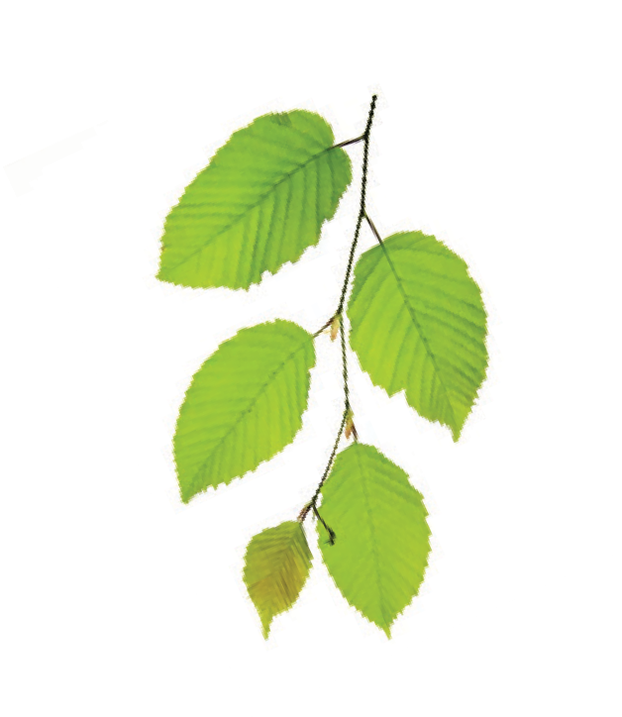
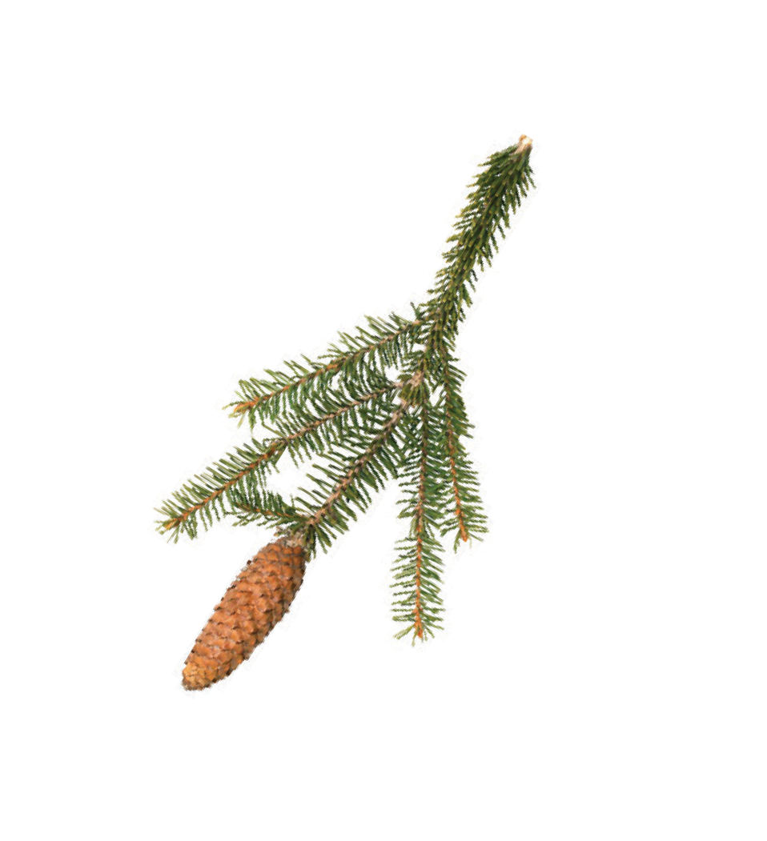
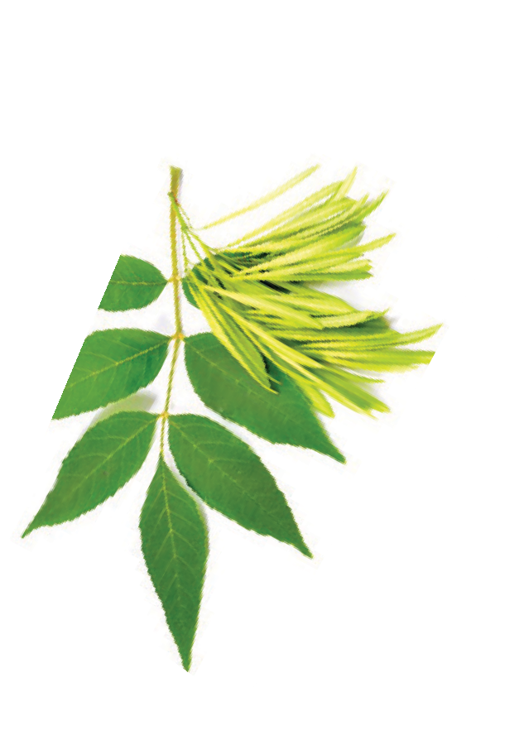
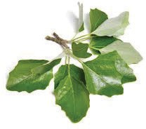
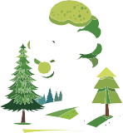
Coniferous and Broadleaf Trees
Hornbeams (Carpinus sp.)
common hornbeam (Carpinus betulus),
black hornbeam (Ostrya carpinifolia)
They are found in forests of central and southern Croatia.
This is the main division of trees which distinguishes them by basic characteristics such as the appearance of leaves, fruit and habitat.
Did you know?!
What we often call a "Christmas pine" is not actually a pine, but a fir tree. Sometimes, a spruce is also used - which we can recognize by the fact that its needles start to fall after a certain period of time.
Spruces (Picea sp.)
common spruce (Picea abies)
Common spruce grows in mountainous and cold regions of Europe, often in high-altitude forests.
Coniferous trees have needles that are usually narrow, hard and have a protective layer of wax. Those trees produce cones as their reproductive organs. Most conifers are evergreen trees, meaning they retain their needles for one or more years.
They are adapted to colder conditions and often grow in mountainous or cold climates. Since they are drought tolerant because they do not lose much water through their needles, they also inhabit Mediterranean areas.
In Europe and the USA, up to 100 million trees are cut annually to be used as Christmas trees. Most of them end up in the trash after use. It is advisable to recycle the "Christmas tree" after use,
rather than throwing it away.
Ash trees (Fraxinus sp.)
field ash (Fraxinus angustifolia), black ash (Fraxinus ornus), common ash (Fraxinus excelsior)
Depending on the species, it inhabits different areas, mountainous and lowland areas and the Mediterranean region.
Poplars (Populus sp.)
white poplar (Populus alba), black poplar (Populus nigra)
They grow along rivers, marshes, and floodplains, often alongside willows and ashes.
Media
Research
Research and list all the coniferous trees that grow in your area.
“Not Every Conifer is a Pine”
08:40 min.

Slide 8
Praxis!
Broadleaf trees have broad, thin leaves that usually fall off during the winter, so most of these species are deciduous trees.
Identify 10 types of deciduous trees in your environment. Sketch and group the different shapes of their leaves (round, oblong, pointed, serrated...).
These trees produce fruits like nuts, fruits in the shell or berries. They grow in all climates with enough rain and heat during the summer.
Many forests include coniferous and broadleaf trees, creating diverse ecosystems that support a variety of plant and animal species.
This diversity contributes to the stability of forest habitats and their adaptability to environmental changes.
Evergreen and deciduous trees
Within the broadleaf group, as well as the conifer group, trees are divided into deciduous and evergreen.
It is very rare for conifer trees to be non-evergreen.
The larch is one such tree—it’s a deciduous conifer that sheds its needles during the winter.
Praxis!
Evergreen and Deciduous Trees
List some types of broadleaf trees and mark which are evergreen and which are deciduous (e.g. olive and laurel are evergreen broadleaves).
Broadleaf trees, although mostly deciduous, can also have evergreen leaves—meaning the leaves don’t fall off in autumn, but remain on the tree. Such a tree is the holm oak, or shrubs like ivy and holly, which retain their leaves for one or more years. We call them evergreens.
Broadleaf tree
Decidious
Evergreen
Downy oak
Laurel

Slide 9
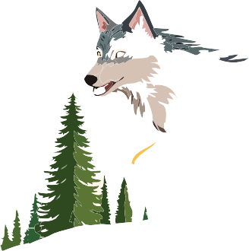
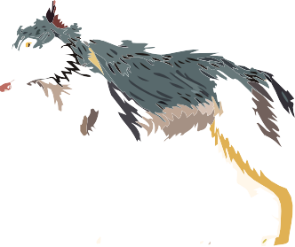
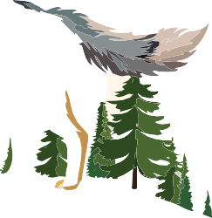
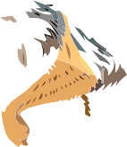
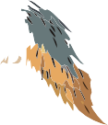
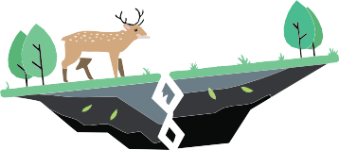
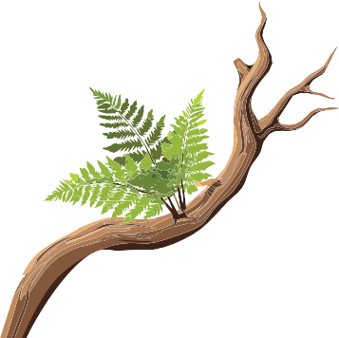
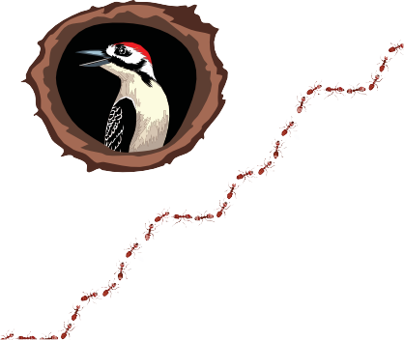
Ecological Relationships in the Forest
Regardless of climatic zones and geographical areas, forests with characteristic species of plants and animals have numerous ecological relationships.
Ecological relationships in the forest include the interactions between different species of plants, animals, microorganisms and their environment. These relationships are crucial for maintaining balance within the forest ecosystem.
Mutualism - is a form of ecological interaction in which both species benefit. It is a type of symbiosis, where mutual cooperation increases the chances of survival, growth, or reproduction of the participants.
Mycorrhizal fungi live in symbiosis with tree roots. They help trees absorb water and minerals from the soil, while in return, they receive carbohydrates produced by the trees through
Aphids feed on plant sap and secrete a sugar-rich liquid (honeydew), which ants consume. In turn, ants protect aphids from predators (e.g., ladybugs).
Commensalism - is an ecological relationship between two different species where one benefits and the other is neither harmed nor helped.
Small mammals (e.g., mice) or amphibians (e.g., frogs) use fallen branches or logs for shelter.
Forest birds (such as woodpeckers or owls) build nests in the cavities of old trees.
Ferns, mosses, lichens, and fungi grow on tree branches or trunks.
Competition - is a relationship in which species compete for the same limited resources, such as food, space, water, or light.
In the forest, trees compete for sunlight, which can affect the growth and survival of young trees.
Roe deer and wild boar often eat similar resources, such as saplings, fruits, and roots. When resources are limited (e.g., in winter), competition for food becomes more intense.
Woodpeckers often make cavities in trees for their nests, but after they leave, starlings can take over these cavities. Sometimes, both species compete for the same hollows.
Birds, bees, butterflies, and bats transfer pollen between plants, enabling reproduction, while they receive food in the form of nectar or pollen.

Slide 10
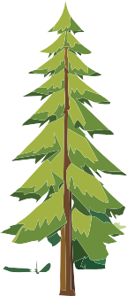
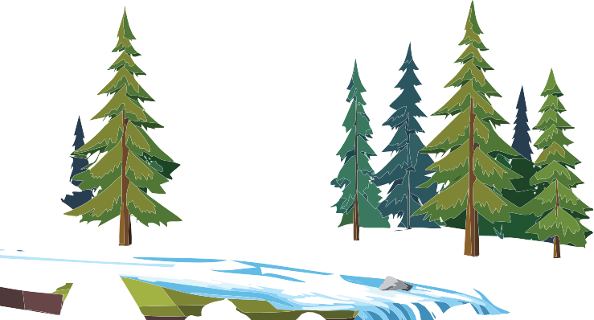
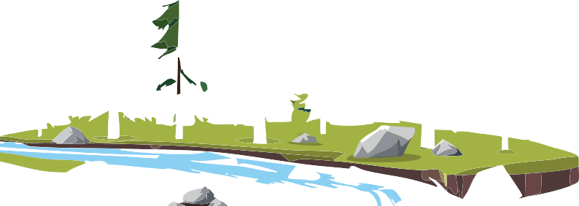
Primeval Forests in Croatia
Predation - is a relationship in which one species (the predator) hunts and eats another species (the prey) to survive.
Owls hunt rodents, which will affect the regulation of their population and reduce damage to plants and seeds.
We most often associate them with lush tropical regions, but primeval forests also exist in Croatia.
These forests are called primeval forests because, unlike other forests, they have never been managed—meaning they have never been cut down.
These are completely natural forests, where old trees fall to the ground when they die and slowly decompose.
Many insects survive in dead trees, and birds, especially woodpeckers, inhabit them, making these forests very rich and abundant in life.
The most famous primeval forests in Croatia are:
Wolves control the deer population by hunting. A reduced deer population prevents overgrazing of young plants, which allows the forest to regenerate.
Čorkova uvala (Plitvice Lakes National Park) - a primeval forest dominated by old beech and fir trees and inhabited by a large number of carnivores.
Spiders trap prey in their webs, reducing the population of harmful insects.
Prašnik - a primeval forest of old Slavonian pedunculate oaks.
This wide range of interactions between species is crucial for maintaining balance and dynamics within a complex forest ecosystem and contributes to the survival and adaptation of different species.
Klepina duliba - a spruce and beech primeval forest in the Štirovača forest vegetation reserve.
Media
"Croatian Primeval Forests"
Ramino korito (Biokovo Nature Park)
- a beech primeval forest on southern Velebit.
Devčića tavani (Northern Velebit National Park) - part of the UNESCO World Heritage Site "Primeval Beech Forests of the Carpathians and Other Regions of Europe".

Slide 11
Praxis!
When the seeds germinate, we will plant them in two vases to monitor their development. We will place them in an environment that suits their needs in terms of light and moisture, and nurture them.
From Seed to Tree
In this exercise, we will grow a tree from a seed.
It is advisable to collect tree seeds in the fall and
store them so that they can be used in the spring.
We will plant seeds of two different trees in parallel to monitor which seeds need more light and heat for their growth and rooting.
It is important to make the soil of sufficient quality for the process of seed germination and its growth into a seedling, and then into a new tree.
Search for questions and
answers in digital format.
Knowledge Quiz
We will observe the planted seeds and monitor which one develops faster in terms of air temperature, soil moisture, and light sources in the environment where the seeds grow.
The seeds will grow into seedlings, which we will transplant into the schoolyard when they become small trees.
What is the main classification of trees based on the shape of their leaves?
In which climate zone do forests have the greatest biodiversity?
How many tree species are there in the Amazon rainforest?
Why is the conservation of tree biodiversity important?
What percentage of Croatia's land area is covered by forests?
Which coniferous tree loses its leaves in winter?
How many tree species are there in Croatia?
What are the species of oaks?
PHASE II
Transplanting seedlings to the schoolyard or surrounding forest
In this phase, we will follow all the rules for planting and transplanting seedlings.
PHASE I
Collecting seeds, preparing soil, and caring for the seeds
It is important to dig a sufficiently deep hole, fill it with natural fertilizer, and place the seedling in the hole. After that, tamp the soil around it well and water it abundantly.
After we collect the seeds, we’ll determine which two are best suited to our climate.
We can take seeds of: oak and hornbeam / spruce and fir / walnut and hazelnut, etc.
We will continue to visit, water, and nurture our little tree, keeping a journal of its progress. Changes in trunk circumference, leaf size, and any other variations in color and shape will be recorded during its first year of growth.
After determining which two seeds we will use, we will prepare them for planting through the process of germination.
What is the ecological relationship in which both individuals benefit?
What are the most famous primeval forests in Croatia?
In this phase, it is important to work on preparing a quality substrate or soil that will allow the seeds to germinate.

Slide 12
Graphic design
Educational materials realized with the support of
Forest Stewardship Council® - Adria-Balkan region program - FSC® F000100
Autor, editor & publisher

