Slide 1
The Magnificent Benefits of Forests
Knowledge Box III

Slide 2
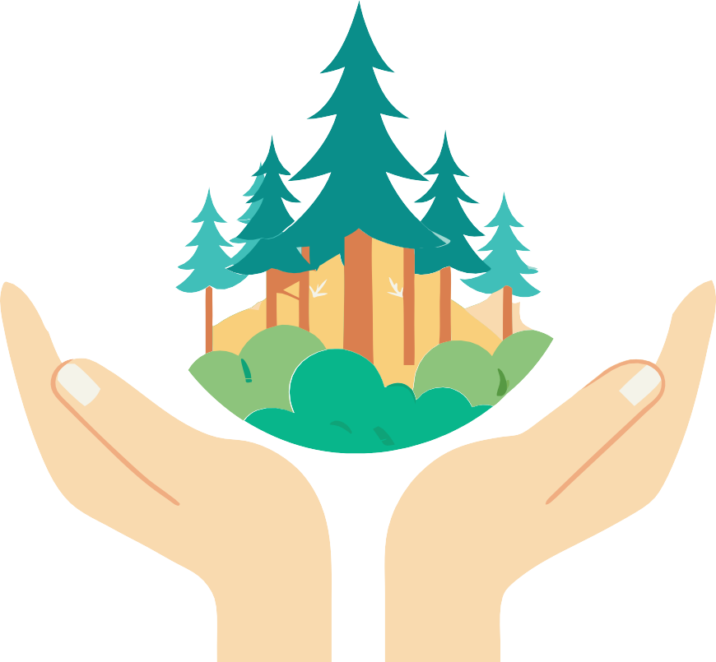
Educational materials realized with the support of
Forest Stewardship Council® - Adria-Balkan region program - FSC® F000100
The well-known motto "without forests, there is no life" reflects the many benefits they provide, which can be divided into ecological, economic, and social gains

Slide 3
Sources
Follow the icons!
Want to know more?
Search here for additional information.
Ecological Benefits 4
Oxygen production 4
Carbon dioxide absorption 4
Biodiversity conservation 6 Other forest ecosystem
services
Social Benefits
Recreation and health
Forests have cultural, spiritual, and educational significance
Did you know?
Keywords
These words are important for a full understanding of the content.
7
7
7
Praxis!
indigenous species
Media
cellular respiration
forest bathing
photosynthesis
8
Economic Benefits
Knowledge Quiz
Research
treasure trove of biodiversity
9
9
ecotourism
non-native species
Use your smartphone to scan QR codes. You'll need an app to scan the code with your camera.
Smartphones are really handy, so let's make the most of them!
greenhouse gases
forest pedagogy
endemic species
education for sustainable development
carbon cycle
Robinson tourism

Slide 4
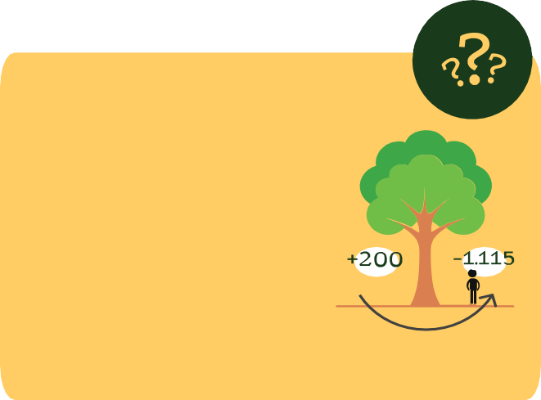
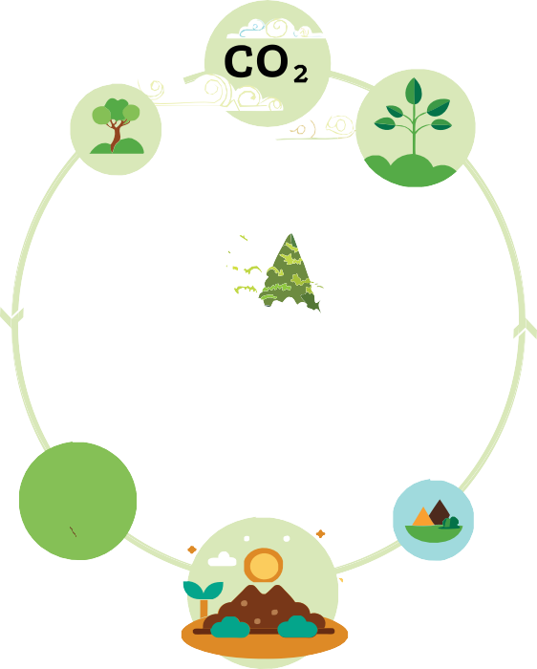
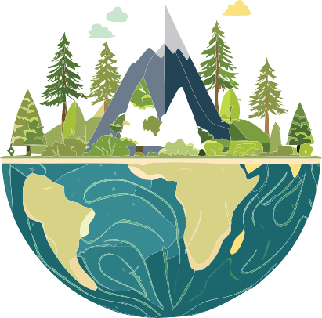
Ecological Benefits
Did you know?!
A mature tree can produce between 100 and 200 kg of oxygen annually.
The average person inhales about 1,115 kg of oxygen per year.
Carbon dioxide absorption
Forests play a vital role in combating climate change by absorbing carbon dioxide (CO₂ ) from the atmosphere.
Trees use CO₂ for photosynthesis, storing carbon in their biomass and releasing oxygen into the atmosphere.
In this way, trees play a key role in the carbon cycle and maintaining the balance in the atmosphere, reducing greenhouse gas levels.
The ecological benefits of forests ensure the life of all beings on planet Earth.
Oxygen production
During photosynthesis, trees use sunlight and water to convert carbon dioxide (CO₂ ) into glucose and oxygen, which is released into the atmosphere.
About 28% of the oxygen in the atmosphere comes from forests, while the rest comes from the ocean, especially from phytoplankton.
These quantities are crucial for maintaining the balance of gases in the atmosphere.
Fast-growing tree species such as poplar and eucalyptus, as well as coniferous species such as pine, fir and spruce, contribute large amounts of oxygen.
Mangrove forests, which are located along the coasts of tropical and subtropical regions, are also significant producers of oxygen.
Like all living things, trees breathe all the time. They use oxygen for their cellular respiration, which allows them to convert the energy stored in glucose into a form that they can use for growth, reproduction, and maintenance.
This happens constantly, day and night, but the oxygen consumption during respiration is much less than the amount of oxygen that plants produce during photosynthesis.
Due to their indispensable role in the survival of life on the planet, forests are also called the - Lungs of the World.
Tropical rainforests and boreal forests are among the most productive in oxygen production. Deciduous forests produce less oxygen because they lose their leaves part of the year.

Slide 5
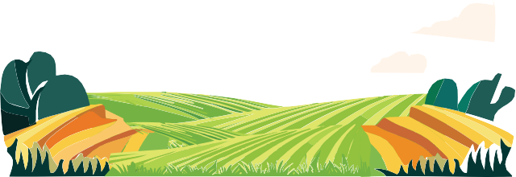
Praxis!
Measuring Oxygen Production in Water!
1. Preparation: Take a small container
of water (e.g. test tube) and fill it with water.
Oxygen production
Measuring oxygen production in a tree can be done with a simple experiment.
Here are some basic methods you can use to measure oxygen production in trees or plants.
Materials:
4. Bubble Tracking: Observe the production of oxygen bubbles coming out of the leaves. Each bubble represents oxygen production.
2. Place the plant in the water: If you are using a smaller plant, place it in the water so that its roots are submerged. If you are using a larger tree, you can work with cut branches
or leaves.
5. Measurement: Record the number of bubbles over a period of time (e.g. 10 minutes).
Plant or tree (e.g., potted plant or young tree)
Lighting (light for photosynthesis, e.g., lamp or sunlight)
Water (to maintain the plant)
Empty bottle or test tube
3. Light exposure: Place the container under a light source (e.g. sunlight or an artificial lamp) to allow photosynthesis to occur.
Record all results and compare different conditions (e.g., different tree species, varying light levels, or soil types). Consider factors affecting results, such as temperature, light intensity, and water availability.
Most of the carbon is stored in the woody parts of trees, such as trunks, branches and leaves. Carbon is also stored in tree roots, which help transfer carbon to the soil through interactions with microorganisms.
Forest soil is an important carbon store. Organic material in the soil, which includes fallen leaves and needles, dead wood and plant debris, contains significant amounts of carbon. Forests often store more carbon in the soil than in the trees themselves, especially in the deeper layers of the soil.
Carbon Cycle
"A tree can retain carbon for decades or centuries as it grows and develops. After a tree dies and begins to decompose, some of the carbon returns to the atmosphere as CO₂ through the decomposition process, while some remains in the soil as organic material – humus."
Did you know?!
One hectare of healthy, growing forests can absorb varying amounts of CO₂.
Tropical forests up to 300 tons
Temperate forests up to 200 tons
Boreal forests up to 70 tons

Slide 6
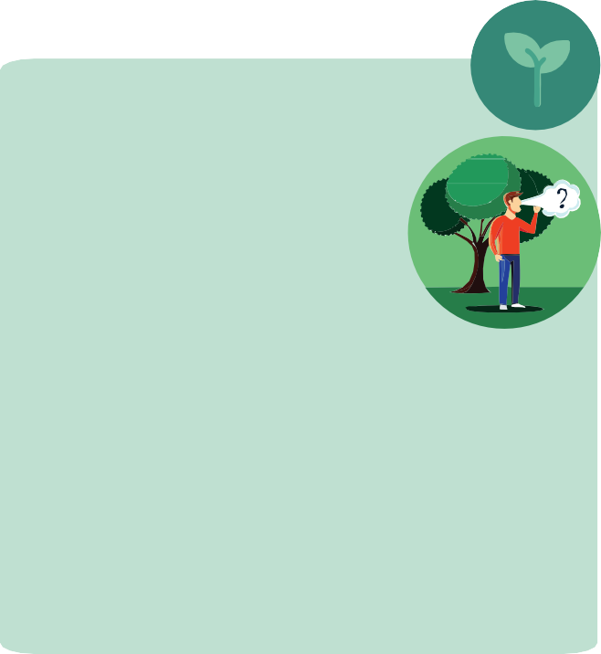
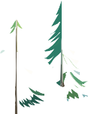
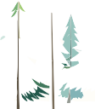
Biodiversity conservation
Praxis!
A mature oak tree absorbs approximately
22 kg of CO₂ annually.
The average person exhales about 365 kg of CO₂ each year.
Calculate:
What is the amount of CO₂ exhaled by humanity on Earth?
Research
Research and list 5 native tree species and 5 non-native tree species in Croatia.
NativeTrees
Non-nativeTrees
In Croatia, one can encounter Mediterranean, mountainous, alpine, and lowland forest communities with their specific climatic and geological characteristics.
Endemic species are species of organisms that are naturally found only in a specific geographical area and do not exist anywhere else in the world.
In Croatia, about 300 endemic plant species are associated with forests and forest habitats.
A large number of endemics are found especially in the Dinarides and on the islands of the Adriatic Sea.
2. How many oak trees would it take to store all that carbon dioxide?
In Croatia, we find 85 different tree species that are native, while the remaining tree species are non-native or introduced from different parts of the world.
Native species belong to a specific geographic area and are adapted to the living conditions of that area. Their presence is the result of natural processes alone.
For example, black pine is a native species, while acacia is a non-native species in Mediterranean.
Due to its diverse flora and fauna, unique ecosystems and the presence of endemic species, Croatia can be considered a treasure trove of biodiversity.
Did you know?!
The combustion of fossil fuels is the largest source of CO₂ emissions on Earth, accompanied by deforestation and certain natural processes such as fires.

Slide 7
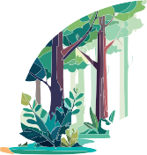
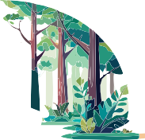
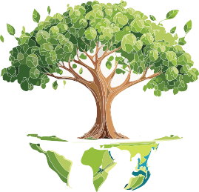
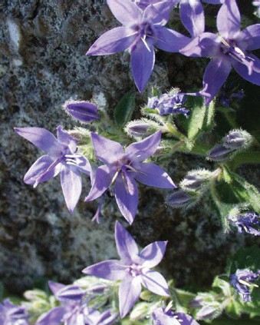
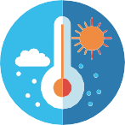
Social Benefits
Research
Investigate which endemic plant and animal species are found in the forests of Croatia.
These benefits of forests are crucial for the quality of life, the preservation of community identity and sustainable development.
List the endemic species that occur in the forests of your region.
Other forest ecosystem services
Media
"Healthy Forests for Healthy People”
Recreation and health
Forests provide a space for recreation, such as hiking, camping, cycling, free climbing and exploring nature.
An active stay in the forest contributes to the overall health of an individual, as the forest offers a stimulating environment that relaxes us and connects us with nature.
Forests..
01:00 min.
...influence the regional and global climate, regulating precipitation and temperature. We can safely conclude that forests play a key role in mitigating the consequences of climate change.
In that direction, forest bathing developed (in Japanese, Shinrin-yoku, which means "bathing in the forest"). It is a practice of connecting with nature through mindful and slow immersion in the atmosphere of the forest. It’s not about literal bathing, but rather spending time in the forest, where a person uses all their senses to relax, calm down, and rejuvenate their physical and mental health.
Forest baths are practiced worldwide, and numerous studies confirm their positive effects on health.
Did you know?!
Istrian Bellflower (Campanula istriaca)
An endemic species that finds its home in Istria and on the islands. This plant is nestled among the cracks of coastal rocks and is one of the most beautiful perennials in the Adriatic.
...with their roots help stabilize the soil and prevent erosion. Trees help retain water in the soil, thus mitigating floods. With their roots, they purify groundwater by filtering.
...protect us from noise, from wind, warm us in winter and cool us in summer.

Slide 8
Media
Forests have cultural, spiritual, and educational significance
Today, people are increasingly returning to the forest to escape the hustle and bustle of urban life, aware of all its benefits that will enhance their daily lives and improve their health.
For many communities, especially indigenous ones, forests are part of their customs, beliefs and traditions.
Forests often appear in folklore and mythology through stories, songs and legends, thus contributing to the preservation of local identity and cultural heritage. Forests offer peace and quiet, so in some cultures they are declared "sacred" places or spaces for spiritual reflection and relaxation.
The natural beauty of forests inspires artists, writers and photographers to create works of art.
“How Forests Heal People”
04:34 min.
“Shinrin-Yoku”
02:23 min.
Do you know?!
Sounds produced by plants and trees can be heard on special devices made for that purpose. We can say that plants produce their own music.
When you're in the forest:
Forests are also real “classrooms” in the open air for children and adults, where it is possible to learn about biodiversity, ecosystems and sustainable development. The practice of education in a forest environment is called forest pedagogy.
10 minutes
blood pressure is lowered, and pulse stabilizes
"Plants Create Music"
20 minutes
mood improves
Through forest pedagogy activities, participants learn about the forest through direct experience and play, using all their senses.
Forest pedagogy as part of education for sustainable development helps to develop ecological awareness and responsibility towards nature.
03:21 min.
1 hour
concentration improves
"Artist Invents Device That Can Listen to Plant Music"
04:07 min.
2 hours
immune system becomes more efficient

Slide 9
Forests are, therefore, much more than a natural resource – they are a key element of human culture, social cohesion and spiritual well-being.
Learn more about wood and forest products in Knowledge Box IV.
Media extra!
"Treehouses in Croatia for a Dream Vacation"
Economic Benefits
The most significant economic benefits from forests are wood and forest products, but also ecotourism.
Search for questions and answers in digital format.
Knowledge Quiz
Many forests attract tourists, offering opportunities for ecotourism, which contributes to the local and national economy and employment in rural areas. The goal of ecotourism is to allow tourists to enjoy natural beauty and cultural attractions with minimal negative impact on the environment, while supporting local communities and encouraging responsible management of natural resources.
Where is carbon stored in forests?
What is the percentage of oxygen that comes into the atmosphere from forests?
What is the most significant contribution of forests to climate change mitigation?
What are native species?
What are the forest ecosystem services?
What are the social functions of forests?
How does being in the forest affect our health and well-being?
What is forest pedagogy?
What are the determinants of ecotourism?
10. What are the most significant economic benefits of forests?
Praxis!
In class, group students into smaller groups. Each group should choose a topic to present either the ecological, social or economic benefits of forests.
One form of ecotourism is Robinson tourism. It is a specific form of tourism that offers an isolated and simple experience, similar to the lifestyle of Robinson Crusoe.
It is based on staying in untouched nature, away from modern technologies and urban infrastructure, with minimal connection to the outside world.
Record a short video on the chosen topic.
Feel free to direct, act in, and edit your video as needed, presenting in a fun and educational way the importance of forests to people.

Slide 10
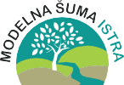
Graphic design
Educational materials realized with the support of
Forest Stewardship Council® - Adria-Balkan region program - FSC® F000100
Author, editor & publisher
12

