Slide 1
Forest Products and Resources
Knowledge Box IV

Slide 2
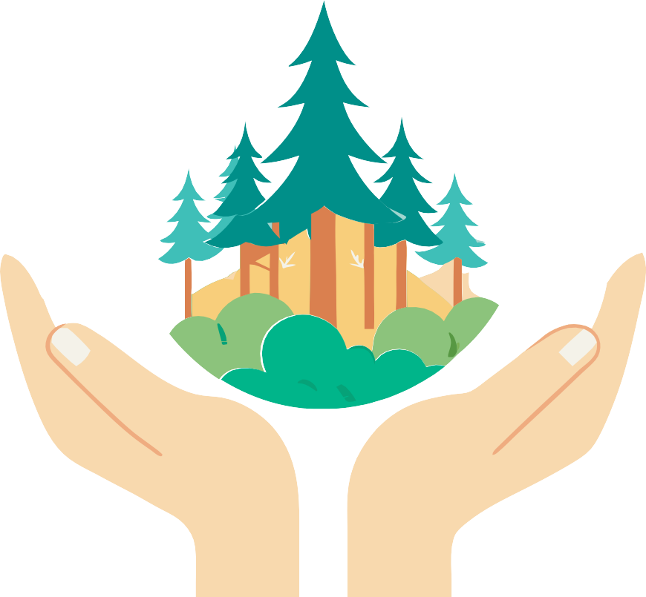
Educational materials realized with the support of Forest Stewardship Council® - Adria-Balkan region program - FSC® F000100
Forests provide us with large amounts of wood resources and food, thus ensuring life on Earth for rural and urban communities

Slide 3
Sources
Wood
Forest Food
Forest Mushrooms
Forest Fruits and Berries
Forest Medicinal and Poisonous Plants
Follow the icons!
4
5
5
6
Want to know more? Search here for additional information.
Did you know?
Keywords
These words are important for a full understanding of the content.
7
Praxis!
Nuts - Proteins from the forest
Forest Honey
Forest Products 10
Resin 10
Rubber 10
Viscose 10
Cork 11
Knowledge Quiz 11
9
9
renewable resource
natural rubber
Media
wood
viscose
wild fruits
resin
rubber tree
Research
cork oak
medun
forests products
Use your smartphone to scan QR codes. You'll need an app to scan the code with your camera.
Smartphones are really handy, so let's make the most of them!
nuts
honeydew
medicinal herbs
cork
wild herbs
essentials oils

Slide 4
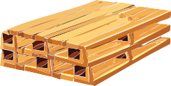
The food, cosmetics, pharmaceutical industries, as well as construction, paper production, and many other sectors, require wood and forest products in their processes. All these forest resources represent the economic benefits we derive from forests.
Wood
The basic material we obtain from the trunks and branches of trees is wood. It consists of layers of fibrous cells that give it structure.
Paper
Wood is processed into paper and paper products such as books, newspapers, notebooks,
and paper and cardboard packaging.
Shipbuilding
Traditionally, wood was used to build ships and boats, and is still used today in restoration and construction of classic wooden vessels.
Firewood
Wood is used as fuel in the form of firewood or wood pellets for heating households, and in industrial processes.
Art
Wood is a popular material for sculptors, carvers, and artists due to its flexibility and natural aesthetics. Numerous art objects are made from wood.
Wood is a renewable resource, provided that forests are managed sustainably. The properties of wood, such as strength, flexibility, and durability, make it an extremely useful material in everyday life.
Here are some of the main uses of wood.
Praxis!
Where's all the wood around me?
Observe what is made of wood and wood products; in your home, at school, in other places where you go, as well as outdoors.
Record with your camera all the products or objects that are made of wood or cellulose. You might be surprised when you realize how much of what’s around you actually comes from the forest.
With the students in the class, group the photos you took; e.g. furniture, structures, paper products, art products, tools and packaging.
Name each recorded item.
Construction, Carpentry, Furniture Wood is used to build houses, buildings, bridges, and other structures. Wooden frames and structural elements are common, especially in residential
buildings.
Chairs, tables, wardrobes, and other pieces of furniture are mostly made of wood.
Various wood products and packaging
Wood is used to make hand tools, musical instruments, toys, and kitchen utensils. It is used to make packaging, so we often use wooden crates, boxes, or pallets. Materials like chipboard and plywood are made from wood waste.
Visit a carpentry shop in your area and learn about the methods and techniques of woodworking.

Slide 5
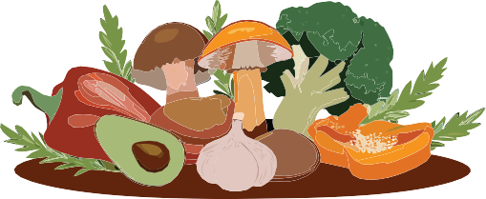
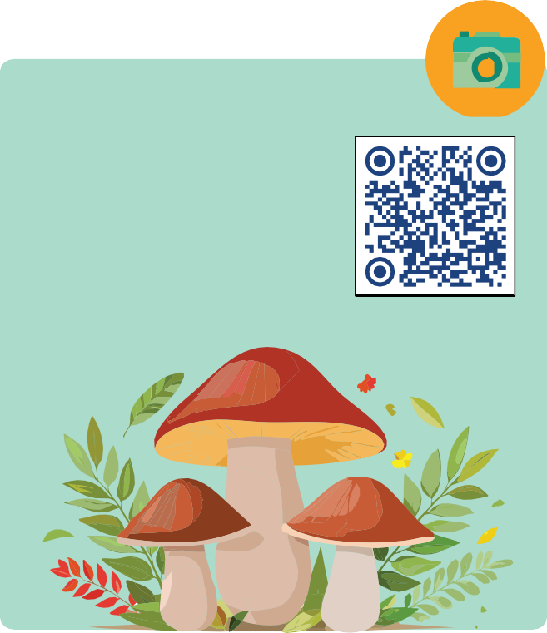
Forest Food
Mushrooms are an important part of forest ecosystems. Among them some are edible,
others are poisonous, and some possess medicinal qualities.
Among the most famous edible mushroom species in Croatia are: Boletes, Chanterelles, Black trumpets, Sun mushrooms and Champignons.
In the north of Istria, we find a valuable habitat of the white truffle, a very expensive and rare underground mushroom. The white truffle grows only in Istria, and in certain regions in Italy and France.
A specific mushroom is the Oak Polypore or Reishi mushroom, which has been known for centuries in China for its exceptional medicinal properties. It has only recently been recognized in our country, despite being very widespread in our forests and growing on the trunks and stumps of oak trees.
Media
“Forests and Innovations – New Solutions for a Better World”
Forests are rich in diverse forest products
- herbs, mushrooms and forest fruits, which we call forest food.
Forest food offers a wealth of taste and nutritional value, and responsibly enjoying these gifts allows us to form a deeper connection to the natural environment.
These various natural resources are used mostly in nutrition, medicine and cosmetics.
04:34 min.
Forest Mushrooms
Over 2,600 species of mushrooms grow in Croatia, and it is estimated that the actual number could be higher because not all species have yet been fully explored.
Media
“Recognizing Mushrooms”
03:50 min.
Did you know?!
Today, we use wood in ways that we could not have imagined before. Materials obtained from forests and trees are being developed as sustain- able substitutes for plastics, fabrics, medicines and many other everyday objects.
In addition to edible and medicinal mushrooms, there are also poisonous species of mushrooms such as the Death Cap and the Red Amanita which are extremely dangerous and can cause severe poisoning and even death.

Slide 6
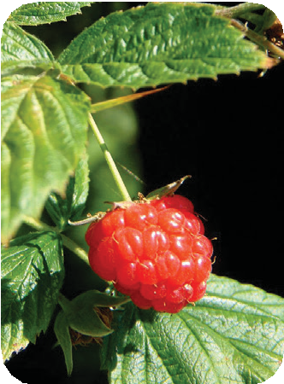
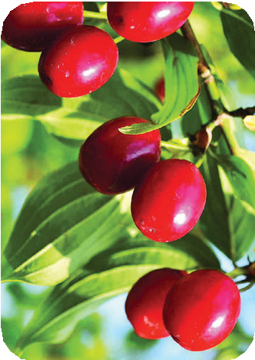
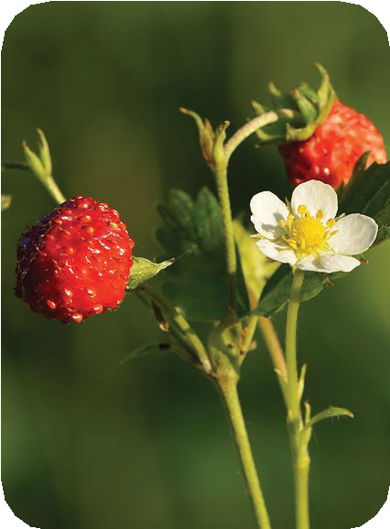
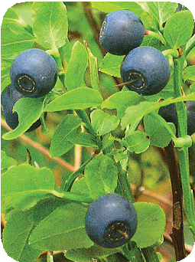
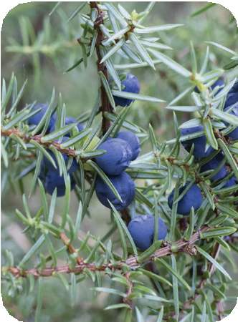
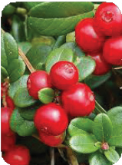
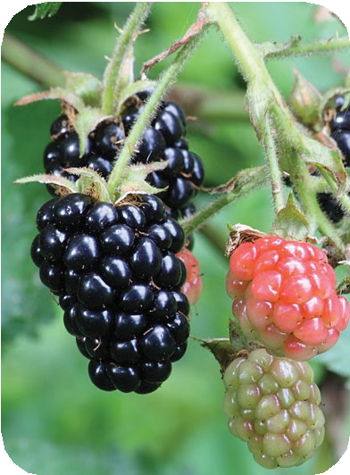
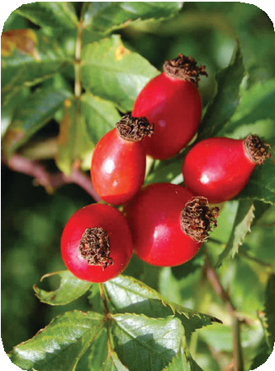
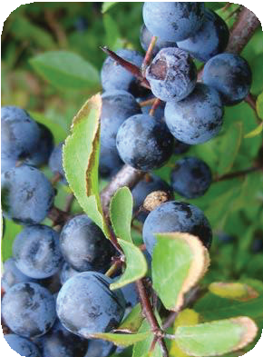
Forest Fruits and Berries
Forest fruits in Croatia include a wide range of wild fruits that grow in natural forest habitats.
These fruits are rich in vitamins, antioxidants and nutrients and are an important part of the diet of many people who enjoy picking forest fruits.
Raspberries
They are common in forests and on mountain slopes. Raspberries are a popular fruit due to their taste and culinary uses.
Cornelian cherry
Its red fruits are small, sour and are used to make jams and syrups. They are traditionally harvested in Dalmatia, Istria and Lika.
The proverb “healthy as a cornelian cherry” is well known.
The most famous forest fruits in Croatia are described below.
Wild Strawberries
They grow in open forest glades and forest edges. They have an intense aroma and taste and are favorites among
forest fruit lovers.
Blueberries
They grow in mountainous areas, are extremely rich in antioxidants and are used to make juices, jams and other products.
Juniper
Its berries are black or dark blue with a recognizable smell and taste. They are widely used, both in natural medicine and in the food industry. Gin is the most famous alcoholic beverage in which juniper berries
are the key ingredient.
Cranberries
They grow in mountainous areas and are popular for their medicinal properties, especially for urinary tract health.
Blackberries
They are found on the edges of forests, along meadows and along forest paths. They are popular for their sweet taste and are used fresh or in various food products.
Blackthorn
It has dark blue, tart berries that become sweeter after the first frosts and are used to make liqueurs and brandies.
Wild Rosehip
Rosehip or wild rose fruits are rich in vitamin C and have medicinal properties.

Slide 7
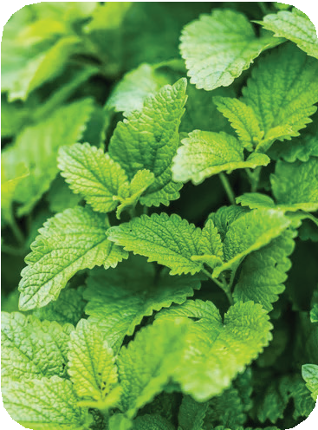
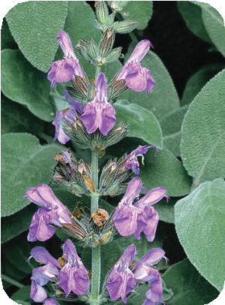
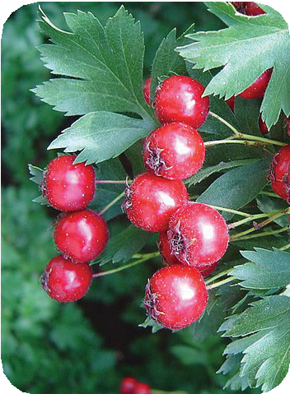
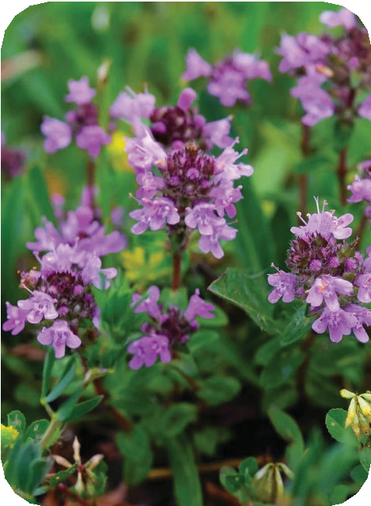
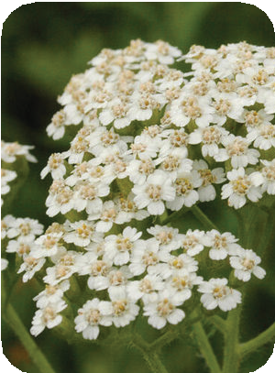
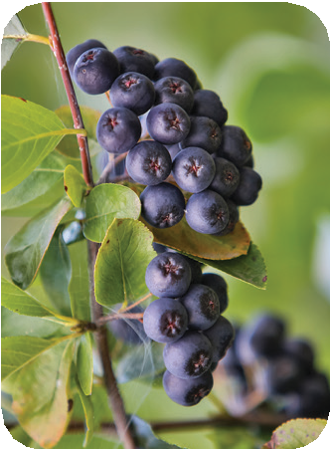
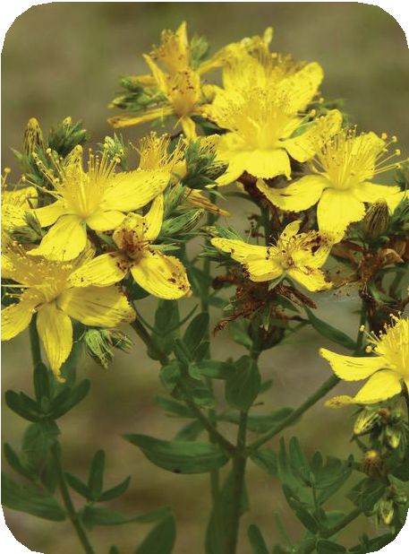
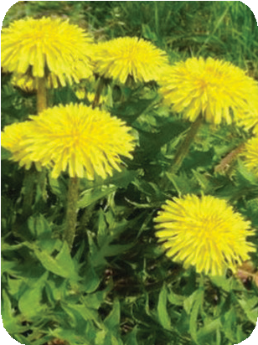
Lemon Balm
It is used to calm, relieve stress and insomnia. Its scent is reminiscent of lemon.
Hawthorn
It is often associated with folk beliefs and is considered a symbol of protection and luck in some cultures. Hawthorn has dense branches with small thorns and red berries that are used in various preparations. It is especially valued for its beneficial effects on the cardiovascular system.
Forest Medicinal and Poisonous Plants
Croatia is extremely rich in medicinal plants thanks to its diverse climate, geographical location and natural habitats. Here are some of the most important medicinal plants that grow in our forests or at their edges.
Sage
It is known for its anti-inflammatory
effect, is also valued as a spice in cooking.
Aronia
Has the highest antioxidant properties among all berries. Its leaves and bark are also used for medicinal purposes. Aronia berries are small, dark fruits popular around the world for their exceptionally valuable nutritional composition.
Thyme
It is used for colds, coughs and bronchitis, but also as a spice in the kitchen.
Yarrow Known for its
anti-inflammatory and antiseptic properties, it is used to treat wounds, digestive problems. Its tea is good for relaxation.
St. John's Wort
It is often used as an oil
for external use on burns and wounds. Tea can be used to treat mild depression and anxiety.
Dandelion
The leaves and root of dandelion are used to cleanse the liver and kidneys, as well as to act as a diuretic. The leaves are used in salads, and the root tea helps with digestion.

Slide 8
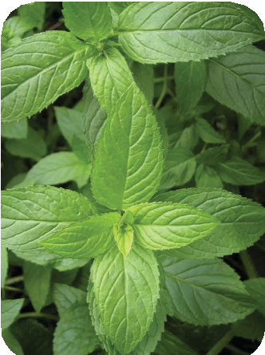
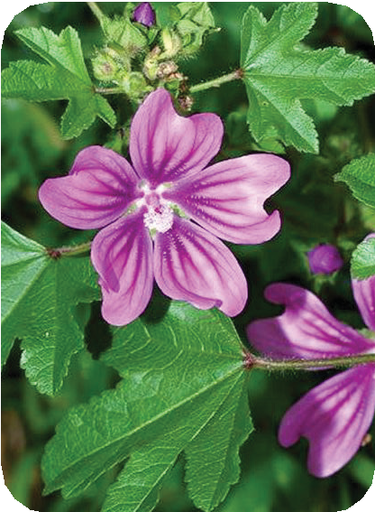
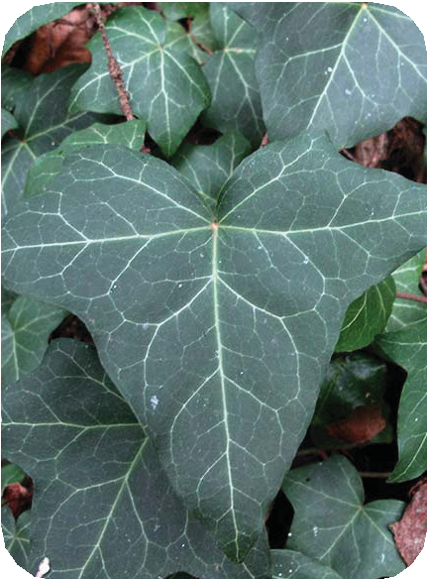
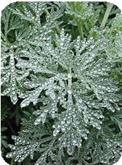
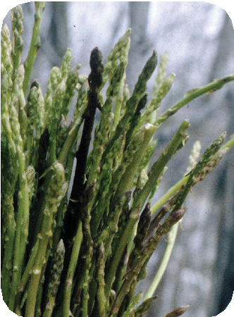
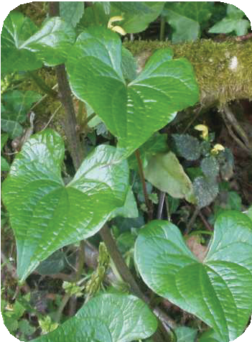
Did you know?!
Mint
It is used for refreshment, for digestive problems, headaches as well as a sedative.
The popular aspirin is derived from the bark of the willow tree (Salix sp.)
Salicin from willow bark has been used for centuries to reduce pain, fever, and inflammation.
Ivy
It is a climber that attaches to surfaces such as trees, walls, or soil using aerial roots. Ivy extracts are used to treat coughs and respiratory problems.
Ivy berries, leaves, and stems are toxic and can cause digestive upset and poisoning in both humans and animals.
The modern pharmaceutical industry developed the drug aspirin (acetylsalicylic acid), a synthetic form of salicylic acid derived from salicin found in willow.
Mallow
It is a wild plant that grows like a weed, but all
its parts are medicinal: the root, leaves and and flowers. Mallows of all types are used as a means of dissolving mucus.
Wormwood
Known for its unpleasant bitter taste and characteristic smell, it has also been used as a medicinal plant for digestion since the time of the ancient Romans.
It is used to make the well-known drink Absinthe and Pelinkovac. Wormwood tea is taken by the spoonful, because it contains the poison thujone, which causes dizziness and headaches.
Asparagus
It has been considered a delicacy since the time of the ancient Egyptians and Romans. Has thin, elongated fleshy stems that are the main part of the plant used for eating. Asparagus is recommended in the diet for its diuretic properties and its support for digestive health.
Wild Yam
Although the tubers of the wild yam are toxic, the young shoots of the plant (similar to asparagus) are traditionally consumed in some regions after proper processing and cooking.
We will recognize it by its smooth, heart-shaped leaves.
Medicinal herbs are used in everyday life,
either as teas, essential oils, tinctures, or
spices, and are an integral part of the
centuries-old tradition of maintaining
health naturally.
.

Slide 9
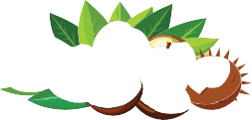
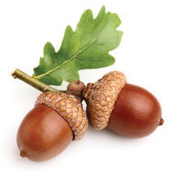
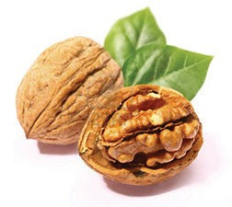
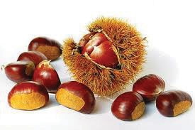
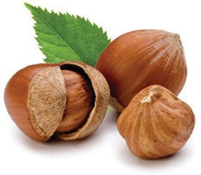
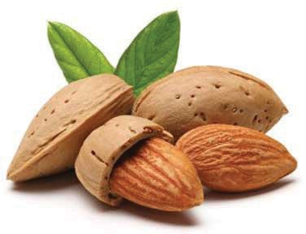
Did you know?!
Forest Honey
Honeydew honey is a specific type of honey that bees produce not from flower nectar, but from honeydew.
Honeydew is the sweet sap secreted by aphids as they feed on the sap of trees such as oak, pine, fir, spruce and linden.
This process most often occurs in the later summer months, when there is less flower nectar and honeydew is available in greater quantities.
Bees collect resin from trees and use it to make propolis, which has powerful antibacterial properties and is used to treat infections, colds and inflammation.
Nuts - Proteins from the forest
Forests are rich in food, including nuts that
we consume raw or process into various
spreads, desserts, liqueurs, and oils.
Acorn
The fruit of an oak tree that has been an important source of food for humans and livestock for centuries.
Today, it is less commonly used in human nutrition, but
is occasionally ground into flour for making bread and biscuits.
This honey is specific for its darker appearance, rich mineral composition and intense, less sweet taste compared to honey obtained from flower nectar.
Forest honeys are also chestnut honey, linden honey and ivy honey that bees produce from the nectar of flowers from these trees.
Walnut
A highly nutritious nut, rich in omega-3 fatty acids and antioxidants.
Chestnuts
There are wild and sweet chestnuts. We use sweet chestnuts in our diet.
Wild almonds
Almonds are rich in monounsaturated fatty
acids. This is the type of acid also found in olive oil, making both of these foods beneficial for heart health. Wild almonds are smaller and more bitter than cultivated almonds and can be poisonous.
The harvest and use of mushrooms, forest fruits, herbs, and berries has a long tradition, especially in rural areas, where these resources are often used domestically or sold at local markets.
Hazelnuts
They grow wild, but are also cultivated. Wild hazelnuts are smaller, but have a rich flavor.
These products are an important part of the rural economy as they provide opportunities for income generation of local communities.

Slide 10
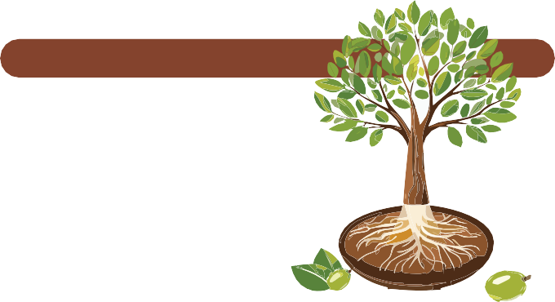
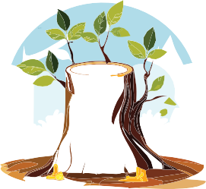
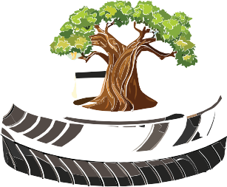
Forest Products
Viscose
Yes, even viscose is considered a forest product as it is obtained by processing cellulose, which comes from wood.
Rubber
As a forest product, a rubber is obtained from various trees that produce latex or resin. Although the most well-known natural rubber today comes from the rubber tree, other types of trees such as pine and their resin can also be used to produce rubber.
The rubber tree (Hevea brasiliensis), native to the tropical forests of South America, is the main source of natural rubber, which is obtained
from its milky sap known as latex.
Resin
It is secreted by certain types of trees,
most often conifers such as pine, spruce and fir.
Resin plays an important role in protecting trees from damage, infections and insects, and it
also has numerous other applications.
Cellulose is the main structural component of plant cell walls, especially abundant in trees, and is used as a raw material for industrial processing.
Viscose is a semi-synthetic fiber made from natural cellulose that is processed through chemical processes. It is widely used in the textile industry because it is soft, breathable, and resembles natural materials like cotton or silk.
Resin is used to produce turpentine, which is used as a solvent in the paint industry, but it is also used in the production of various types of glue.
Essential oils extracted from the resin are used in the manufacture of perfumes, creams and soaps.
Viscose is obtained by grinding wood and processing it into cellulose pulp, which is then chemically treated to form a thick substance known as viscose, which is hardened and made into a textile fiber.
Unlike fully synthetic fibers (such as polyester), viscose is of natural origin and biodegradable, making it a better choice for the environment.
Rubber is obtained by making incisions in the tree bark and collecting the oozing latex, which is then processed into rubber.
Resin is used on violin, viola, cello and double bass bows, as it helps create friction between the strings and the bow.
Natural rubber is used to make a variety of products, from vehicle tires to medical and industrial products.

Slide 11
Cork
Cork is a natural material obtained from the bark of the cork tree (Quercus suber), a type of oak that grows in the forests of the Mediterranean.
The bark of the cork oak is covered with cork, which is removed manually with special tools to avoid damaging the tree. The collected bark is dried for several months, then processed to obtain the final product.
Search for questions and answers in digital format.
Knowledge Quiz
Which are two poisonous mushroom species?
Where in the world does the white truffle grow?
Which types of forest fruits have red berries?
Which types of wild forest plants are partially poisonous?
Which medicinal plants are used in cooking?
How is honeydew honey obtained?
Which forest products do we use in everyday life?
What do we get from processing tree resin?
In which industries is wood used?
Which forest fruits are rich in protein?
This oak is known for its ability to regenerate its bark, which allows for
sustainable cork harvesting without harming the tree.
Cork is a lightweight, resilient, waterproof and natural material that has a wide range of applications in everyday life.
The most famous use of cork is for making wine stoppers due to its air and moisture impermeability. Cork is also used for insulation and in the
creation of various decorative, fashion, and utility items.
It is increasingly being used as a replacement for plastic in various industries due to its sustainability.
Cork is a unique forest product that shows how nature can provide sustainable resources with minimal impact on the environment.
Praxis!
Forest Food
Choose a forest that you will visit in the fall.
This practice is organized as a group work.
Collect forest fruits and medicinal herbs in textile bags.
Upon returning to the classroom, identify what you have collected from the fruits and medicinal herbs.
For this "forest food", gather recipes for processing it into various food products or preparations, such as tinctures, juices, jams, and more. At school, you can brew tea from freshly picked medicinal herbs and drink it, likely feeling its positive effects on your body immediately.

Slide 12
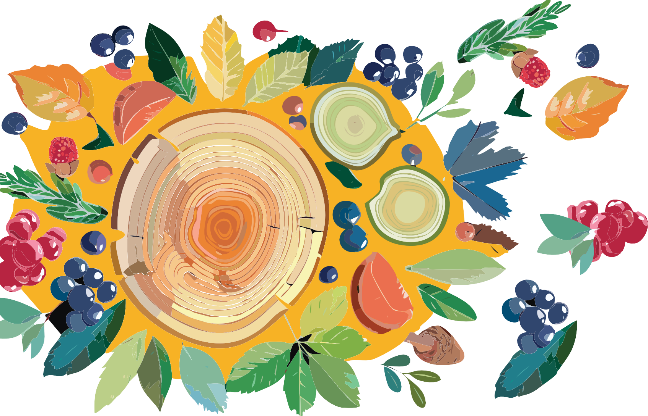
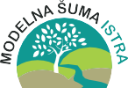
Graphic design
Educational materials realized with the support of
Forest Stewardship Council® - Adria-Balkan region program - FSC® F000100
Author, editor & publisher

