Slide 1





Let's Save Our Forests!
Knowledge Box V

Slide 2




Educational materials realized with the support of
Forest Stewardship Council® - Adria-Balkan region program - FSC® F000100pod
Conserving forests requires global action and locally responsible resource management to ensure biodiversity protection and sustainable forest use

Slide 3






Sources
Sustainable Forest Management
The Biggest Threats to Forests Today
Forest Conservation and Protection
Croatian forests and the FSC certificate
Croatia is rich in natural forests
Forests Are Direct Sources of Renewable Energy
New Solutions for a Better World
Knowledge Quiz
Follow the icons!
Want to know more?
Search here for additional information.
4
4
Did you know?
Keywords
These words are important for a full understanding of the content.
6
6
Praxis!
invasive species
Media
climate change
7
agroforestry
ecosystem services
national parks
Natura 2000
Research
nature parks
8
8
9
cascading wood use
sustainable development
Use your smartphone to scan QR codes. You'll need an app to scan the code with your camera.
Smartphones are really handy, so let's make the most of them!
deforestation
wood biomass
production forests
urbanization
sustainable forest management

Slide 4


The Biggest Threats to Forests Today
What are the basic principles of sustainable forest management?
Selective felling of trees to preserve the ecological balance of the forest, reduce deforestation and ensure the natural growth of new trees.
Reforestation and planting of new trees after felling helps to restore forest areas and preserve biodiversity.
Forests are under significant pressure due to the impacts of climate change, human activities, and biological threats.
Sustainable Forest Management
Sustainable development refers to the balance between economic growth, environmental protection and social well-being, and forests are an important part of that balance due to the numerous ecosystem services they provide.
Protecting forests and conserving forests through legal protection, national parks and nature reserves is key to long-term sustainability.
Deforestation refers to the permanent destruction of forests to make way for agriculture, livestock farming, infrastructure and urbanization.
It is common in tropical regions, but it is also occurring in other parts of the world.
Encouraging and involving local communities in forest management fosters sustainable use of forest resources, while also supporting economic development and poverty reduction."
Climate change is having a serious impact on forest ecosystems around the world. Increasing temperatures, droughts and changes in weather patterns are making forest ecosystems more vulnerable to fires, diseases and degradation. Climate change is forcing species to migrate to cooler areas, causing disruption to forest ecosystems and biodiversity loss.
Sustainable forest management involves managing forest resources in a way that meets current needs without compromising the ability of future generations to use the same resources.
Sustainable forest management is important
for preserving natural resources for future generations, reducing the impact of climate change and preserving biodiversity.

Slide 5








Unsustainable logging refers to the exploitation of forests faster than they can naturally regenerate.
Urbanization and infrastructure expansion cause forest fragmentation, creating smaller and isolated forest units that cannot maintain the same ecological functions as large, continuous forest areas.
Fragmentation also reduces the ability of species to migrate and adapt to climate change.
Increased temperatures allow pests and diseases to spread, which can devastate forest populations. Insect species such as bark beetles are becoming more active due to rising temperatures, putting more pressure on forests, especially conifers.
Intensive logging, as well as irresponsible exploitation of forest resources and illegal activities, significantly threaten forest resources.
Some birds in Croatia, such as the black bunting and forest owls, are shifting their migration patterns due to changes in climate and food availability. A growing number of bird species are adjusting their arrival and departure times, while some species are retreating to colder areas.
Invasive species are plants, animals, or microorganisms introduced into forest ecosystems where they are not naturally present. They can have a destructive impact because they often lack natural predators in the new environment and can outcompete native species.
Did you know?!
According to reports from organizations like FAO (Food and Agriculture Organization of the United Nations), it's estimated that globally disappear...
... 10 million hectares of forests annually ≈ 27,000 hectares daily
This means that every day, forests disappear over an area equivalent to approximately 38,000 football fields (as one football field covers about 0.7 hectares).
The most affected areas are tropical regions, particularly the Amazon, parts of Africa, and Southeast Asia.
Biodiversity loss in forests is the result of a combination of factors such as deforestation, climate change, habitat fragmentation and invasive species.
Forests are home to many plant and animal species, and when forests are destroyed or degraded, species lose their habitats and often become extinct.
Praxis!
Take a walk through a natural area and photograph negative impacts that could lead to species loss or habitat degradation.
Threats to forests today also include illegal activities related to ecosystems and the exploitation of non-timber forest products.

Slide 6
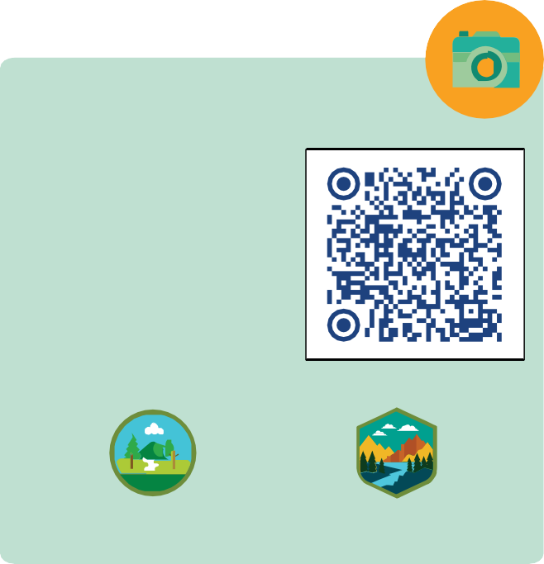

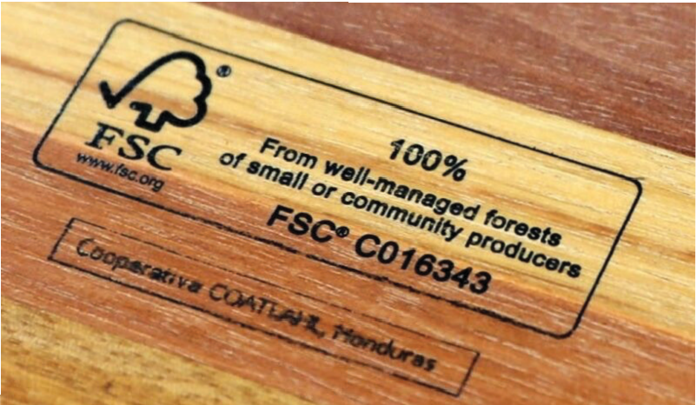

Forest Conservation and Protection
Media
“National Parks and Nature Parks in Croatia”
Did you know?!
In the past 30 years, the forested area in Europe has increased by approximately 9%. The primary cause is the abandonment of agricultural land and the decline in farming activities in rural areas, leading to natural succession and forest expansion.
Europe, including Croatia, can attribute the increase in forest cover also to sustainable forest management policies, where tree harvesting is aligned with the natural regeneration of forests.
Note that all European countries, along with the USA and Canada, have implemented forest protection programs that support sustainable forest management and the reforestation of degraded areas, helping to maintain stable forest cover.
04:34 min.
There are numerous laws and initiatives aimed at preserving biodiversity, including the
Natura 2000 network, which covers important habitats and species in the EU and mandates their protection.
12 Nature Parks
8 National Parks
National Parks and Nature Parks also contribute to the conservation of forest ecosystems and biodiversity by implementing management plans that protect the natural environment within their boundaries.
Croatia has 8 National Parks and 12 Nature Parks, safeguarding key ecosystems and species.
Croatian forests and the FSC certificate
Sustainable forest management is based on principles that support the balance of nature, the economy, and society.
Croatia is a good example of this, as it has created an effective system for protecting forest resources and using them wisely.
Special attention is given to the conservation of forests that serve as habitats for protected and rare species, such as the European lynx, brown bear, wolf, and numerous plant species.

Slide 7





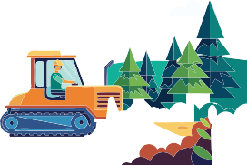


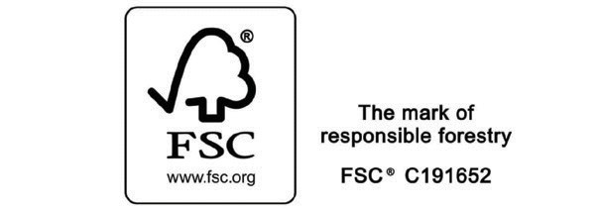








Forests in Croatia are mostly state-owned (around 76%) and are managed by the public company Croatian Forests Ltd.
The legal framework and forestry policy in Croatia strictly regulate the principles of sustainable forest management.
Croatian Forests Ltd. holds the internationally recognized FSC (Forest Stewardship Council) certificate, which confirms that forests are managed according to high sustainability standards.
Croatia is rich in natural forests
Croatia is among the top 5 countries with the highest percentage of natural forests in Europe, along with countries such as Finland, Sweden, and Slovenia.
Croatia stands out for its high proportion of native natural forests, which account for as much as 95% of the total forest area—a rarity compared to many European countries.
This high percentage of natural forests is a result of sustainable management, as forests regenerate naturally after logging with minimal human intervention.
Such a high proportion of natural forests makes Croatia extremely valuable in global efforts to conserve natural forest ecosystems.
The FSC certification ensures: Harvesting does not exceed the natural forest regeneration rate
In many Western European countries, industrialization, urbanization, and intensive agriculture have led to a significant loss of natural forests over the centuries.
Did you know?!
Not every harvest is forest devastation.
Most logging is planned for forest clearance and regular maintenance.
The forestry sector in Croatia monitors the state of forests through forest management plans, which are updated every 10 years.
These plans include detailed analyses of the condition of forests, as well as predictions of how much timber can be sustainably harvested without endangering the ecosystem.
Preservation of forests' ecological functions, including soil, water, climate, and biodiversity protection
Natural forests have been replaced by production forests, which are often monocultures or artificially planted by tree species that are not always native.
Natural forests provide key ecosystem services, such as carbon storage, biodiversity conservation, soil protection, and water resource regulation.
They are usually more effective in long-term CO₂ absorption compared to artificially planted forests, especially monocultures.
Respect for the rights of local communities and forestry sector employees
You can spot the FSC label on various wood-based products. It is globally recognized as one of the most important indicators that wood comes from a sustainably managed forest.

Slide 8
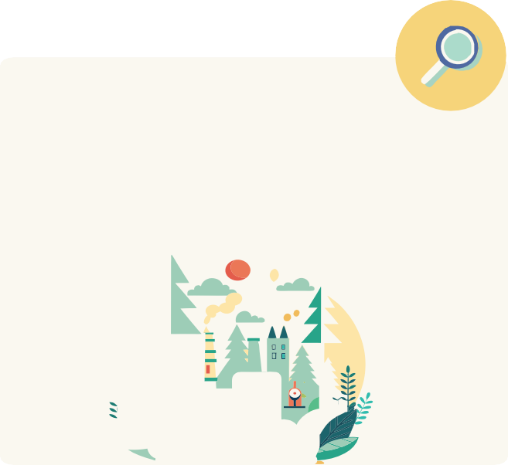
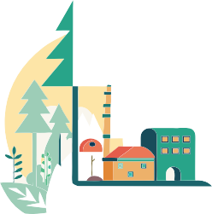


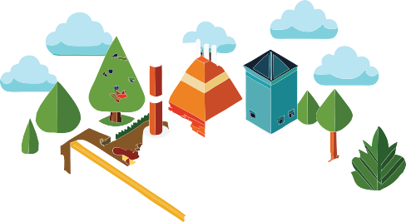
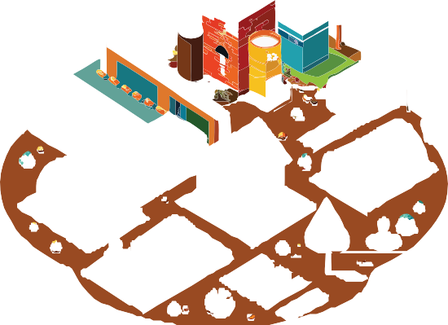

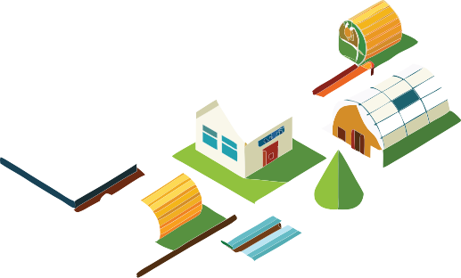














New Solutions for a Better World
Forests Are Direct Sources of Renewable Energy
Biomass is considered one of the most important renewable energy sources that comes from forests.
Wood biomass replaces fossil fuels and thus reduces greenhouse gas emissions, making forests an important part of the energy transition towards renewable energy sources and a sustainable energy future.
Research
What are the different ways biomass is obtained, and how is it used in industry and households?
Agroforestry is a sustainable land management approach that combines agricultural crops and/or livestock with tree cultivation on the same land.
This model helps improve productivity, restore soil, and increase biodiversity while simultaneously utilizing multiple resources on the same land area.
Wood biomass comes from a variety of organic sources, including branches, roots, and wood waste generated during logging.
Forms of agroforestry:
Systems with rows of trees and crops
Sometimes, biomass is obtained from fast-growing forests that are cultivated solely for energy production.
Biomass is used to produce pellets and briquettes, which serve as heating fuel, especially in households and small industrial facilities.
Pasture and tree systems
Forest gardens
Windbreaks

Slide 9


















Encouraging agroforestry, which combines agriculture and forestry, provides long-term positive environmental benefits and aligns with modern trends and policies in forestry and sustainable agriculture.
Key Principles of Cascading Wood Use
Wood should be used in a value hierarchy:
Search for questions and answers in digital format.
High-value products such as furni- ture, construction materials, or paper should be produced before lower-value products.
Products should be reused, recycled, or repurposed as much as possible.
Burning wood for energy should only occur when it can no longer be used for processing.
Knowledge Quiz
What are the basic principles of sustainable forest management?
What is deforestation?
What are the reasons for the increase in forest cover in Europe?
What does the FSC label on various wood-based products represent?
What is the percentage of natural forests in Croatia?
What is the name of the EU program aimed at protecting biodiversity?
What are the nature parks in Croatia?
What are the benefits of using wood biomass?
Which countries are at the top in Europe by percentage of natural forests?
10. What are the advantages of natural forests compared to production forests?
Cascading use of wood is a resource management concept promoted by the European Union to ensure the efficient use of wood as a limited resource.
Priority is given to high-value and
long-lasting applications of wood before its final use for energy production.
This approach is in line with the EU's goals for efficient resource use, the circular economy, and sustainability.
The concept encourages the extension of the wood lifecycle by designing durable and repairable products and promotes recycling at the end of their first use phase.
The cascade approach supports the circular bioeconomy, where resources are used for as long as possible to increase their value and reduce waste.
Slido
An online interactive platform designed for teachers, students, and anyone who wants to learn through games with friends.

Slide 10







Grafičko oblikovanje
Educational materials realized with the support of
Forest Stewardship Council® - Adria-Balkan region program - FSC® F000100
Autor, urednik & izdavač

